Slide 1


Slide 2
A Programmatic Introduction to Neo4j
Ian Robinson
http://ianSrobinson.com
@ianSrobinson
Jim Webber
http://jimwebber.org
@jimwebber
Notes:
Thanks to: Glen Ford and Nigel Small for poking around early iterations of these Koans

Slide 3
A Programmatic Introduction to Neo4j
Jim Webber
Chief Scientist, Neo Technology
@jimwebber
Notes:
Thanks to: Glen Ford and Nigel Small for poking around early iterations of these Koans

Slide 4
Logistics
08:30 Tutorial starts
10:00 Coffee
12:00 Lunch
13:30 Tutorial resumes
15:00 Coffee break
15:30 Tutorial resumes
17:00ish End of day

Slide 5
Roadmap
Hello, Timelords!
NOSQL overview
Neo4j fundamentals and tools
Core API
Indexing
Traverser APIs
Cypher
Graph algorithms
Pattern Matching
REST API, Extensions, and Security
Solutions architecture and big data
Whirlwind tour of things we didn’t cover
End

Slide 6
Koans Because if you do not know it yourself, it does you no good
Tutorial: http://tinyurl.com/neo4j-koans
Source: https://github.com/jimwebber/neo4j-tutorial
Notes:
We are not looking for a specific answer but for evidence that the student has grasped the problem presented by the kōan

Slide 7
Why NOSQL now?
Driving trends

Slide 8
Trend 1: Data Size

Slide 9
Trend 2: Connectedness
GGG
Onotologies
RDFa
Folksonomies
Tagging
Wikis
Information connectivity
UGC
Blogs
Feeds
Hypertext
Text Documents
Notes:
UGC = User Generated Content
GGG = Giant Global Graph (what the web will become)

Slide 10
Trend 3: Semi-structured information
Individualisation of content
1970’s salary lists, all elements exactly one job
2000’s salary lists, we need many job columns!
All encompassing “entire world views”
Store more data about each entity
Trend accelerated by the decentralization of content generation
Age of participation (“web 2.0”)

Slide 11
Trend 4: Architecture
1980’s: Single Application
Application
DB

Slide 12
Trend 4: Architecture
1990’s: Integration
Database Antipattern
Application
Application
Application
DB

Slide 13
Trend 4: Architecture
2000’s: SOA
RESTful, hypermedia, composite apps
Application
Application
Application
DB
DB
DB

Slide 14
Side note: RDBMS performance
Salary list
Most Web apps
Social Network
Location-based services
Notes:
This is strictly about connected data – joins kill performance there.
No bashing of RDBMS performance for tabular transaction processing
Green line denotes “zone of SQL adequacy”

Slide 15
Four NOSQL Categories

Slide 16
Four NOSQL Categories
Aggregate-Oriented Databases
Notes:
Fowler points out that KV/Column/Document stores are all aggregates: they’re different from graphs because they enforce structure at design time – as an aggregate of data.
Clump of data that can be co-located on a cluster instance and which is accessed together.
“a fundamental unit of storage which is a rich structure of closely related data: for key-value stores it's the value, for document stores it's the document, and for column-family stores it's the column family. In DDD terms, this group of data is an aggregate.”

Slide 17
Key-Value Stores
“Dynamo: Amazon’s Highly Available Key-Value Store” (2007)
Data model:
Global key-value mapping
Big scalable HashMap
Highly fault tolerant (typically)
Examples:
Riak, Redis, Voldemort
Notes:
History – Amazon decide that they always wanted the shopping basket to be available, but couldn’t take a chance on RDBMS
So they built their own
Big risk, but simple data model and well-known computing science underpinning it (e.g. consistent hashing, Bloom filters for sensible replication)
+ Massive read/write scale
- Simplistic data model moves heavy lifting into the app tier (e.g. map reduce)

Slide 18
Pros and Cons
Strengths
Simple data model
Great at scaling out horizontally
Scalable
Available
Weaknesses:
Simplistic data model
Poor for complex data

Slide 19
Column Family (BigTable)
Google’s “Bigtable: A Distributed Storage System for Structured Data” (2006)
Data model:
A big table, with column families
Map-reduce for querying/processing
Examples:
HBase, HyperTable, Cassandra

Slide 20
Pros and Cons
Strengths
Data model supports semi-structured data
Naturally indexed (columns)
Good at scaling out horizontally
Weaknesses:
Unsuited for interconnected data

Slide 21
Document Databases
Data model
Collections of documents
A document is a key-value collection
Index-centric, lots of map-reduce
Examples
CouchDB, MongoDB

Slide 22
Pros and Cons
Strengths
Simple, powerful data model (just like SVN!)
Good scaling (especially if sharding supported)
Weaknesses:
Unsuited for interconnected data
Query model limited to keys (and indexes)
Map reduce for larger queries
Notes:
Mongo DB has a reputation for taking liberties with durability to get speed
Couch DB has good multimaster replication from Lotus Notes

Slide 23
Aggregate-Oriented Databases
http://martinfowler.com/bliki/AggregateOrientedDatabase.html
“There is a significant downside - the whole approach works really well when data access is aligned with the aggregates, but what if you want to look at the data in a different way? Order entry naturally stores orders as aggregates, but analyzing product sales cuts across the aggregate structure. The advantage of not using an aggregate structure in the database is that it allows you to slice and dice your data different ways for different audiences.
This is why aggregate-oriented stores talk so much about map-reduce.”

Slide 24
complexity = f(size, connectedness, uniformity)
Notes:
Neo4j is designed for complex data
Complexity is multifacted, it’s not just big
But is some combination of big, connected, and semi-structured.

Slide 25
Graph Databases
Data model:
Nodes with properties
Named relationships with properties
Hypergraph, sometimes
Examples:
Neo4j (of course), Sones GraphDB, OrientDB, InfiniteGraph, AllegroGraph
Notes:
People talk about Codd’s relational model being mature because it was proposed in 1969 – 42 years old.
Euler’s graph theory was proposed in 1736 – 275 years old.

Slide 26
Pros and Cons
Strengths
Powerful data model
Fast
For connected data, can be many orders of magnitude faster than RDBMS
Weaknesses:
Sharding
Though they can scale reasonably well
And for some domains you can shard too!
Notes:
Can’t easily shard graphs like documents or KV stores.
This means that high performance graph databases are limited in terms of data set size that can be handled by a single machine.
Can use replicas to speed things up (and improve availability) but limits data set size limited to a single machine’s disk/memory.
Some domains can shard easily (.e.g geo, most web apps) using consistent routing approach and cache sharding – we’ll cover that later.

Slide 27
Social Network “path exists” Performance
Experiment:
~1k persons
Average 50 friends per person
pathExists(a,b) limited to depth 4
Caches warm to eliminate disk IO
 | # persons | query time
Relational database | 1000 | 2000ms

Slide 28
Social Network “path exists” Performance
Experiment:
~1k persons
Average 50 friends per person
pathExists(a,b) limited to depth 4
Caches warm to eliminate disk IO
 | # persons | query time
Relational database | 1000 | 2000ms
Neo4j | 1000 | 2ms

Slide 29
Social Network “path exists” Performance
Experiment:
~1k persons
Average 50 friends per person
pathExists(a,b) limited to depth 4
Caches warm to eliminate disk IO
 | # persons | query time
Relational database | 1000 | 2000ms
Neo4j | 1000 | 2ms
Neo4j | 1000000 | 2ms

Slide 30
What are graphs good for?
Recommendations
Business intelligence
Social computing
Geospatial
MDM
Systems management
Web of things
Genealogy
Time series data
Product catalogue
Web analytics
Scientific computing (especially bioinformatics)
Indexing your slow RDBMS
And much more!

Slide 31
Neo4j is a Graph Database
So we need to detour through a little graph theory

Slide 32

Meet Leonhard Euler
Swiss mathematician
Inventor of Graph Theory (1736)
http://en.wikipedia.org/wiki/File:Leonhard_Euler_2.jpg

Slide 33



http://en.wikipedia.org/wiki/Seven_Bridges_of_Königsberg
Notes:
Euler reduced the problem into an abstract form
From geography to diagrammatic through to a graph.
It’s the first documented case of representing the real world as a graph.

Slide 34
On maturity of data models
Notes:
Codd’s RDBMS is heralded as the gold standard for enterprise data because of its maturity, yet Codd’s model is only 42 years old in 2011
Euler’s graph model is 275 years old!

Slide 35






Koans: https://github.com/jimwebber/neo4j-tutorial

Slide 36










stole
companion
from
loves
loves
appeared
in
enemy
companion
appeared
in
appeared
in
enemy
enemy
appeared
in
appeared
in
A Good Man Goes to War
Victory of
the Daleks
appeared
in

Slide 37
This has huge design implications

Slide 38

What you end up with
What you know
Your awesome new graph database
http://talent-dynamics.com/tag/sqaure-peg-round-hole/
Notes:
Common design misunderstanding is to impose a relational model onto the graph DB – effectively taking a RDBMS dump and importing it.
- Won’t be good, we’ve seen people trying to do this with mainframes via COBOL copybooks and it doesn’t work
- You have to think!
Think in terms of entities (nodes) and their relationships (edges). Not in terms of entities and actions (e.g. email sleuthing problem)
Draw the email sleuthing problem on the whiteboard.

Slide 39
Property Graph Model

Slide 40
Property Graph Model
TRAVELS_WITH
LOVES
TRAVELS_WITH
BORROWED
year : 1963
TRAVELS_IN

Slide 41
Property Graph Model
name: the Doctor
age: 907
species: Time Lord
TRAVELS_WITH
LOVES
TRAVELS_WITH
BORROWED
year: 1963
first name: Rose
late name: Tyler
TRAVELS_IN
vehicle: tardis
model: Type 40

Slide 42
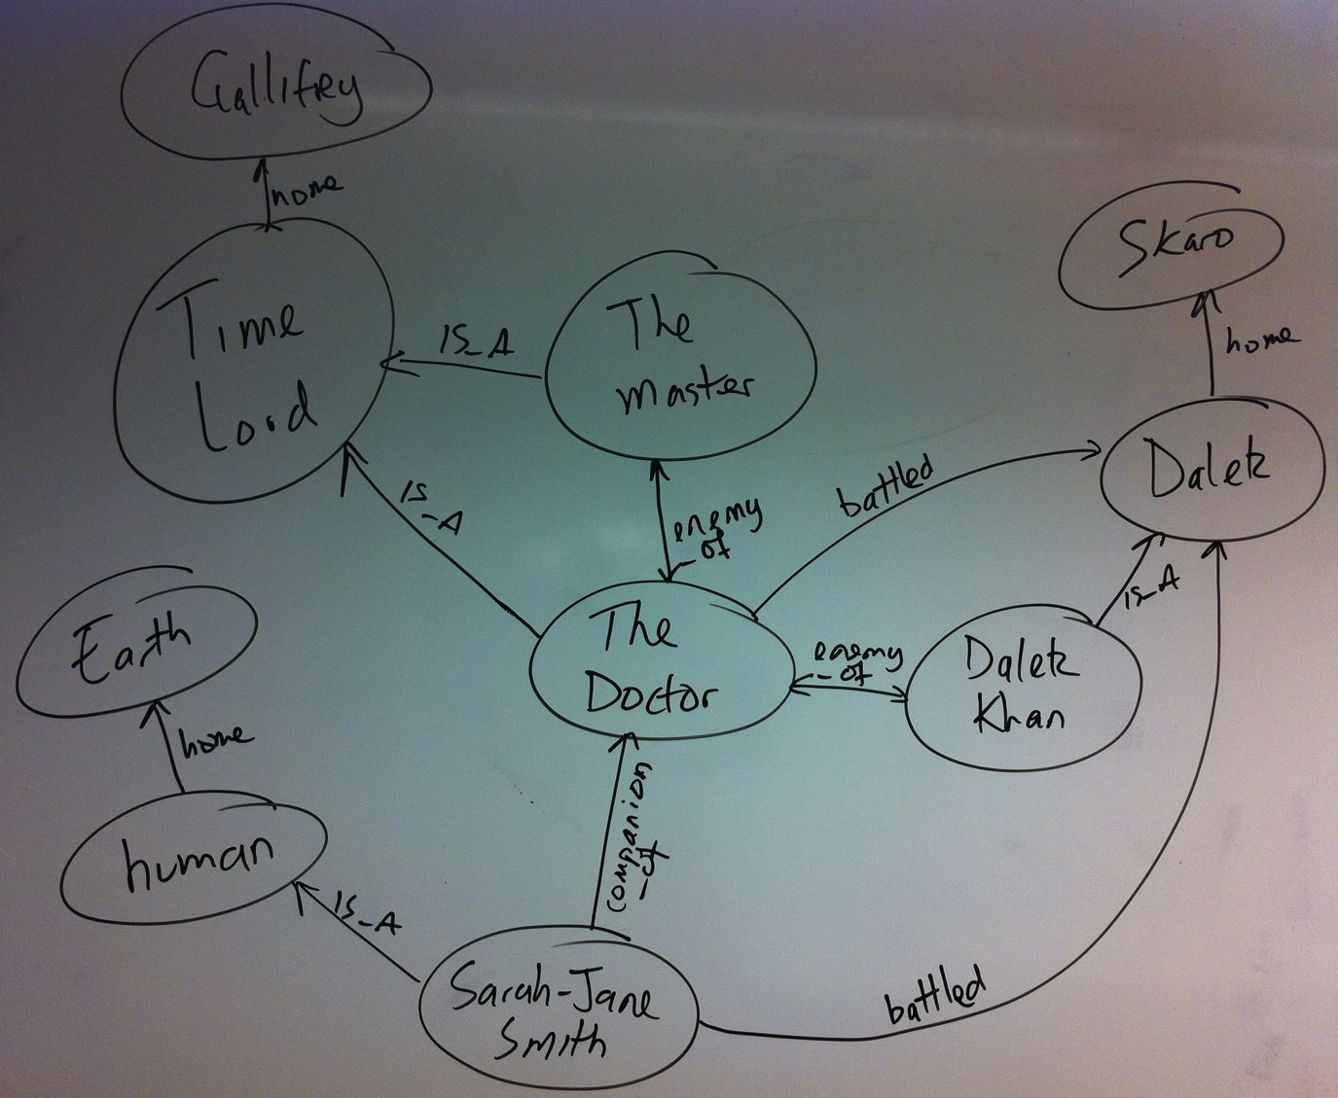
Graphs are very whiteboard-friendly
Notes:
Start off sketching the domain. That’s your model done – we see this when we revisit databases months after they’re been designed and put into production
No decomposition, ER design, normalisation/denormalisation as you need with RDBMS.

Slide 43
Schema-less Databases
Graph databases don’t excuse you from design
Any more than dynamically typed languages excuse you from design
Good design still requires effort
But less difficult than RDBMS because you don’t need to normalise
And then de-normalise!
Notes:
Dynamically typed languages are late bound – the functionality is there when you need it. Graph DBs are analogous – you make use of the data that’s there when you need it
In designing the Doctor Who database for this tutorial, we had many design decisions to make.
- How to represent species that are enemies?
- And how to represent individuals that are enemies?

Slide 44
Neo4j

Slide 45
What’s Neo4j?
It’s is a Graph Database
Embeddable and server
Full ACID transactions
We don’t mess around with durability, ever.
Schema free, bottom-up data model design
Notes:
We are enterprise militants!
Acid always
Java first
Enterprise first
Tens not hundreds in a cluster
For highly connected data models – we’re not a KV store
We are GPL’d – you can use us for free if you can use MySQL for free

Slide 46
More on Neo4j
Neo4j is stable
In 24/7 operation since 2003
Neo4j is under active development
High performance graph operations
Traverses 1,000,000+ relationships / second on commodity hardware

Slide 47
License
Community edition is GPLv3
The core graph db functionality, including server, Webadmin tool
Free as in beer
Advanced edition is AGPL/commercial
Adds monitoring/management features
Enterprise edition is AGPL/commercial
Adds HA and online backup

Slide 48
Neo4j Logical Architecture
REST API
Java
Ruby
…
Clojure
JVM Language Bindings
Graph Matching
Core API
Traversal Framework
Caches
Memory-Mapped (N)IO
Filesystem
Notes:
Filesystem:
- files on disk.
- We lay them out very care so that we can calculate offsets and jump to any record in the files quickly.
- We love SSDs because we can still get stung by spinning disks at this level, but in a second I’ll show how we alleviate that.
- We have separate stores for nodes, relationships, properties, and optimisations for common cases to ensure that data is found in one file (e.g. short strings)
Memory-mapped NIO. We use Java NIO, which is fast!
Caches:
- Our special sauce. Caches allow us to work fast even with spinning disks – they give us millions of traversals per second on laptop-quality hardware
Core API:
- Low level graph abstractions, imperative in nature. Can be highly efficient
- Trade off is low-level programming
Traversal Framework:
- The “query layer”
- We have one stable and one experimental version
- Declaratively describe what to look for in a graph, not so much how.
JVM Language bindings:
- Remember we’re a Java database, so anything can bind to us. We have a Java API, that API has been consumed and adapted to suit JRuby, Jython, Clojure, Scala, etc
REST API:
- A proper, discoverable, hypermedia-driven REST API. Useful if you’re off the JVM or just want to treat the database as a server on the network

Slide 49
Remember, there’s NOSQL
So how do we query it?

Slide 50
http://browsertoolkit.com/fault-tolerance.png

Slide 51
http://browsertoolkit.com/fault-tolerance.png

Slide 52
http://browsertoolkit.com/fault-tolerance.png

Slide 53
Data access is programmatic
Through the Java APIs
JVM languages have bindings to the same APIs
JRuby, Jython, Clojure, Scala…
Managing nodes and relationships
Indexing
Traversing
Path finding
Pattern matching

Slide 54
It’s almost time for us to do some of that programmatic stuff
But first let’s setup our toolset

Slide 55
Download the Koans (or install from a USB stick in class)
http://bit.ly/koans-neo4j

Slide 56
Koan Setup
The koans can be run from the supplied Ant script
The ant lib.retrieve target will download all the necessary dependencies using ivy
They can also easily be imported into an IDE like Eclipse or Intellij
The ant generate.eclipse.project target will create an Eclipse project file for you too
Fast feedback for running the koans
Remember that Ant integrates well with modern IDEs too!

Slide 57
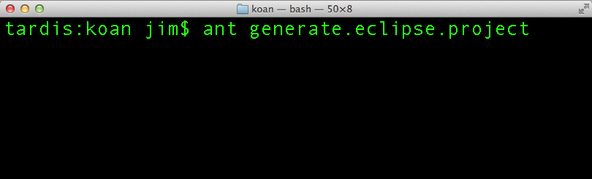
Get the project in your IDE
Eclipse: open the generated project
IntelliJ: new project, open as external model

Slide 58
Koan 1
Tools

Slide 59

Neoclipse
http://wiki.neo4j.org/content/Neoclipse_Guide
Notes:
Eclipse RCP based tool, pre-built for Mac, Windows, Linux
Point it at a database directory and start to visualise. Great for debugging graphs.
Note: DB must be cleanly shut down for Neoclipse to work.
Run koan01.java to produce a sample database and obtain its path on the filesystem

Slide 60
Neo4j Shell
See: http://docs.neo4j.org/chunked/snapshot/shell.html
Command-line tool, based on the unix shell
Server mode
Connect to a running server
Use –port and –name switches to connect
File mode
Bind to a Neo4j store, just like Neoclipse
Use –path switch
Readonly mode with –readonly switch

Slide 61
Launching the shell (mac/unix)
#!/bin/sh
# Set this to your own project directory
PROJECT_DIR=/Users/jim/neo/development/neo4j-tutorial
LIB_DIR=$PROJECT_DIR/lib
java -cp $LIB_DIR/neo4j-jmx.jar:$LIB_DIR/neo4j-community.jar:$LIB_DIR/neo4j-server.jar:$LIB_DIR/neo4j-cypher.jar:$LIB_DIR/neo4j-kernel.jar:$LIB_DIR/neo4j-shell.jar:$LIB_DIR/neo4j-graph-algo.jar:$LIB_DIR/neo4j-lucene-index.jar:$LIB_DIR/lucene-core.jar:$LIB_DIR/neo4j-graph-matching.jar:$LIB_DIR/neo4j-server-static-web.jar:$LIB_DIR/scala-library.jar:$LIB_DIR/geronimo-jta_1.1_spec.jar org.neo4j.shell.StartClient -path $1

Slide 62
Launching the shell (windows)
REM Set this to your own project directory
set PROJECT_DIR=Z:\MYDO~0F4\neo\development\neo4j-tutorial
set LIB_DIR=%PROJECT_DIR%\lib
java -cp %LIB_DIR%/neo4j-jmx.jar;%LIB_DIR%/neo4j-community.jar;%LIB_DIR%/neo4j-server.jar;%LIB_DIR%/neo4j-cypher.jar;%LIB_DIR%/neo4j-kernel.jar;%LIB_DIR%/neo4j-shell.jar;%LIB_DIR%/neo4j-graph-algo.jar;%LIB_DIR%/neo4j-lucene-index.jar;%LIB_DIR%/lucene-core.jar;%LIB_DIR%/neo4j-graph-matching.jar;%LIB_DIR%/neo4j-server-static-web.jar;%LIB_DIR%/scala-library.jar;%LIB_DIR%/geronimo-jta_1.1_spec.jar org.neo4j.shell.StartClient -path %1

Slide 63
Shell Commands
cd
ls
cd <node-id> traverse one relationship to the adjacent node id.
cd -a <node-id> traverse to node id.
cd -r <relationship-id> traverse to a relationship which has the current node as either start or end. To see the relationship ids use the ls -vr command on nodes.
cd -ar <relationship-id> absolute change to any relationship.
cd .. traverses back one step.
cd start traverses to the start node of the relationship
cd end traverses to the end node of the relationship.
ls lists the current node/relation
ls *foo* lists anything matching the regex
-i ignores case
ls -d filters on direction
INCOMING, OUTGOING, BOTH
in, out, both
i, o, b

Slide 64
Shell Commands
mkrel
rmrel
mkrel –c for node
mkrel –t for relationship
mkrel -t "LIKES" -d OUT –c creates a “likes” relationship to a new node
As mkrel, but removes nodes and relationships

Slide 65
Setting, Changing, Removing Properties
set
-t optional type
set name "The Doctor"
set -t int age 904
set -t String[] goodies ["sonic screwdriver", "jelly babies"]
mv
mv name character
rm
rm character

Slide 66
Neo4j Server
Starting/stopping
Managing
Mac/Linux
bin/neo4j start
bin/neo4j stop
Windows
bin\Neo4j
Funky Webadmin tool on port 7474 by default
http://localhost:7474

Slide 67

Demo
Notes:
The Doctor Who data set shown in this slide is available by running any of the koans. Running koan01.java is best since all it does is create the database on disk and print out the path to that database on the console. Incidentally you can use that path to examine the database in Neoclipse too.

Slide 68
Exercise
Browse the Doctor Who Database with Neoclipse
CRUD some nodes and relationships
Interact with the Doctor Who database via the shell
CRUD some nodes and relationships

Slide 69
Koan 2
Java API Graph Fundamentals

Slide 70
Core API
Nodes
Properties
KV Pairs
Optional
Relationships
Start node
Mandatory
End node
Which can be the same as the start node
Mandatory
Properties
KV Pairs
Optional
Notes:
Low-level access to fundamental primitives: nodes and relationships
Properties are string keys and JVM string/primitive/array values.
One constraint only enforced: relationships must have a start and end node – no dangling links in Neo4j.

Slide 71
Creating Nodes
GraphDatabaseService db =
new GraphDatabaseFactory() .newEmbeddedDatabase("/tmp/neo");
Transaction tx = db.beginTx();
try {
Node theDoctor = db.createNode();
theDoctor.setProperty("character", "the Doctor");
tx.success();
} finally {
tx.finish();
}
Notes:
All mutating operations on nodes, relationships (and later indexes) must be performed within a transaction.

Slide 72
Creating Relationships
Transaction tx = db.beginTx();
try {
Node theDoctor = db.createNode();
theDoctor.setProperty("character", "The Doctor");
Node susan = db.createNode();
susan.setProperty("firstname", "Susan");
susan.setProperty("lastname", "Campbell");
susan.createRelationshipTo(theDoctor, DynamicRelationshipType.withName("COMPANION_OF"));
tx.success();
} finally {
tx.finish();
}
Notes:
Relationship types can be strings as we’re using here
Or they can be enums if you want the benefits of static typing in your IDE
e.g. public enum MyRels implements RelationshipType
In fact, anything with a name() method returning a String can act as a RelationshipType
Either way they’re treated the same by the DB engine – no difference in performance or richness.

Slide 73

Repeat...until…

Slide 74
Exercise
CRUD some nodes and relationships
Understand properties on both nodes and relationships
Understand directions for relationships
Understand deletion semantics

Slide 75
Koan 3
Indexing

Slide 76
DoctorWhoUniverse
Most koans use {Embedded, Server}DoctorWhoUniverse to set up the database
It’s a wrapper around Neo4j’s GraphDatabaseService which loads the dataset
There are some helpers in here you can use
theDoctor()
Always returns the Doctor node
characterIndex, planetIndex, speciesIndex, actorIndex, episodeIndex …
Provides direct access to other interesting nodes in the graph
Notes:
Now we start to interact with the data set for real, and the DoctorWhoUniverse class helps with that.

Slide 77

Graphs are mostly self-indexing
Notes:
We don’t use indexes as much in graphs as we do in RDBMS/Document stores because graphs are their own indexes. We tend to use indexes only as a shortcut for remembering interesting (sets of) nodes.
Here’s a graph of all the doctor’s companions. To “index” them all we need to do is find the doctor node and look for incoming “COMPANION_OF” relations
Remember that graph traversals are quick – 1M per second on commodity hardware, so looking finding all of the Doctor’s companions from the Doctor node is fast.

Slide 78
Indexing a Graph?
Graphs are their own indexes!
But sometimes we want short-cuts to well-known nodes
Can do this in our own code
Just keep a reference to any interesting nodes
Indexes offer more flexibility in what constitutes an “interesting node”

Slide 79
No free lunch
Indexes trade read performance for write cost
Just like any database, even RDBMS
Don’t index every node!
(or relationship)
Notes:
Just index key nodes – the pillars or themes that underpin your domain
In Doctor Who, we index the main characters and planets, and species since these are good starting nodes for traversals.

Slide 80
Lucene
The default index implementation for Neo4j
Default implementation for IndexManager
Supports many indexes per database
Each index supports nodes or relationships
Supports exact and regex-based matching
Supports scoring
Number of hits in the index for a given item
Great for recommendations!

Slide 81
Creating a Node Index
GraphDatabaseService db = …
Index<Node> planets = db.index().forNodes("planets");
Type
Create or retrieve
Type
Index name

Slide 82
Creating a Relationship Index
GraphDatabaseService db = …
Index<Relationship> enemies = db.index().forRelationships("enemies");
Create or retrieve
Type
Type
Index name

Slide 83
Exact Matches
GraphDatabaseService db = …
Index<Node> actors = doctorWhoDatabase.index() .forNodes("actors");
Node rogerDelgado = actors.get("actor", "Roger Delgado") .getSingle();
Key
Value to match
First match only

Slide 84
Query Matches
GraphDatabaseService db = …
Index<Node> species = doctorWhoDatabase.index() .forNodes("species");
IndexHits<Node> speciesHits = species.query("species", "S*n");
Key
Query

Slide 85
Must use transactions to mutate indexes
Mutating access is still protected by transactions
Which cover both index and graph
GraphDatabaseService db = …
Transaction tx = db.beginTx();
try {
Node nixon= db.createNode();
nixon.setProperty("character", "Richard Nixon");
db.index().forNodes("characters").add(nixon, "character", nixon.getProperty("character"));
tx.success();
} finally {
tx.finish();
}
Notes:
Incidentally Richard Nixon becomes a Doctor Who character in the most recent series!

Slide 86

For Debugging: Neoclipse Supports Indexes

Slide 87
Exercise
Retrieve a named index from a DB instance
Mutate an index (along with its graph)
Query an index

Slide 88
Koan 4
Auto-Indexing

Slide 89
What’s an auto index?
It’s an index that stays consistent with the graph data
Prior to 1.4, you did this work
Manual indexes still best for integration cases
Auto indexing trades a little power for a lot of laziness!
Notes:
Integration cases are where you have an external system with some foreign key that you want to map onto a node/rel in Neo4j. Manual indexes allow arbitrary keys, hence you can use the foreign identifier.
NB: auto-indexing means a single index only right now.

Slide 90
Auto index lifecycle
On creation, specify the property name that will be indexed
If node/relationship or property is removed from the graph, it will be removed from the index
Stop indexing a property
Any node/rel you touch which has that property will be removed from the auto index
Re-indexing is a manual activity (1.4)
Existing properties won’t be indexed unless you touch them
Notes:
Caution:
If you start the database with auto indexing enabled but different auto indexed properties than the last run, then already auto-indexed entities will be deleted as you work with them.
Make sure that the monitored set is what you want before enabling the functionality.

Slide 91
Using an Auto-Index
Relationship Indexes Supported
AutoIndexer<Node> nodeAutoIndex = graphDb.index().getNodeAutoIndexer();
nodeAutoIndex.startAutoIndexingProperty ("species");
nodeAutoIndex.setEnabled( true );
ReadableIndex<Node> autoNodeIndex = graphDb.index().getNodeAutoIndexer() .getAutoIndex();
Notes:
It’s a ReadableIndex because you’re not allowed to mess with it – that would ruin the point of it being automatic

Slide 92
Exercise
Set up an auto index
Verify that it’s populated as you create matching nodes
Notes:
This is a bit of a typing exercise – there’s no real work to do in the indexing, but you should learn how to set up an auto index.

Slide 93
Koan 5
Idiomatic Searches

Slide 94
Mixing Core API and Indexes
Indexes are typically used only to provide starting points
Then the heavy work is done by traversing the graph
Can happily mix index operations with graph operations to great effect

Slide 95
Exercise
Use named index, traverse graph with core API
actors index, actor = “William Hartnell”
Find starting point with index query, traverse graph with core API
Find starting points with index query, traverse graph with core API

Slide 96
Koan 6
Simple Traversal API

Slide 97
Comparing APIs
Core
Traversers
Basic (nodes, relationships)
Fast
Imperative
Flexible
Can easily intermix mutating operations
Expressive
Fast
Declarative (mostly)
Opinionated

Slide 98
(At least) Two Traverser APIs
Neo4j has declarative traversal frameworks
What, not how
There are two of these
And development is active
No “one framework to rule them all” yet

Slide 99
Simple Traverser API
Mature
Designed for the 80% case
In the org.neo4j.graphdb package
Node daleks = …
Traverser t = daleks.traverse( Order.DEPTH_FIRST,
StopEvaluator.DEPTH_ONE,
ReturnableEvaluator.ALL_BUT_START_NODE,
DoctorWhoRelations.ENEMY_OF,
Direction.OUTGOING);
Notes:
Finds who the Daleks are enemies of.
Result: the Doctor (of course), the timelords, and the cybermen!
Note in this case the order doesn’t matter since we’re only going to depth one.
StopEvaluator can also be END_OF_GRAPH or custom implementation based on TraversalPosition
ReturnableEvaluator can be ALL or custom implementation based on TraversalPosition

Slide 100
Custom ReturnableEvaluator
Traverser t = theDoctor.traverse(Order.DEPTH_FIRST,
StopEvaluator.DEPTH_ONE,
new ReturnableEvaluator() {
public boolean isReturnableNode(TraversalPosition pos)
{
return pos.currentNode().hasProperty("actor");
}
},
DoctorWhoRelations.PLAYED, Direction.INCOMING);
Notes:
Finds who the Daleks are enemies of.
Result: the Doctor (of course), the timelords, and the cybermen!
Note in this case the order doesn’t matter since we’re only going to depth one.
StopEvaluator can also be END_OF_GRAPH or custom implementation based on TraversalPosition
ReturnableEvaluator can be ALL or custom implementation based on TraversalPosition

Slide 101
Exercise
Use default parameters in traverser API to traverse the graph
Use customised ReturnableEvaluator to populate the returnable set of nodes for a traversal, using the traverser API

Slide 102

Dalek Props
http://www.dalek6388.co.uk/

Slide 103

The Doctor and The Master

Slide 104
Koan 7
“New” Traverser API

Slide 105
“New” Traverser API
Newer (obviously!)
Designed for the 95% use case
In the org.neo4j.graphdb.traversal package
http://docs.neo4j.org/chunked/milestone/tutorial-traversal.html
Traverser traverser = Traversal.description()
.relationships(DoctorWhoRelationships.ENEMY_OF, Direction.OUTGOING)
.depthFirst()
.uniqueness(Uniqueness.NODE_GLOBAL)
.evaluator(new Evaluator() {
public Evaluation evaluate(Path path) {
// Only include if we're at depth 2, for enemy-of-enemy
if(path.length() == 2) {
return Evaluation.INCLUDE_AND_PRUNE;
} else if(path.length() > 2){
return Evaluation.EXCLUDE_AND_PRUNE;
} else {
return Evaluation.EXCLUDE_AND_CONTINUE;
}
}
})
.traverse(theMaster);
Notes:
Enemy of my enemy example
Default expander gives constraints about which relationship types can be traversed.
Specific expander implementations can be used to prioritise specific relationships
Depth/breadth first are built-in orderings – can make your own
Breadth-first tends to be more memory hungry
Uniqueness constraints – some of them can be memory hungry
If you don’t specify uniqueness constraint, you get NODE_GLOBAL, which is memory hungry (emulate behaviour of old traverser API)
Evaluator implementation is where your code goes.
Key here to evaluate the path object at each step in the graph.
Path gives us current node and access to the traversed path, current node (and its relationships etc)

Slide 106
TraversalPrinter
The class TraversalPrinter will give you step by step output as a traversal runs
Useful for debugging
Implements Evaluator, so compose it with your Evaluator
new TraversalPrinter(
new Evaluator()
{
// implementation elided
}, "actor", "character" )

Slide 107
Exercise
Follow the regeneration path to find how many doctors there have been by using the new traversal framework and a custom Evaluator
Find the first Doctor by using the new traversal framework and a custom Evaluator
Beware of Richard Hurdnall

Slide 108

The Doctor

Slide 109
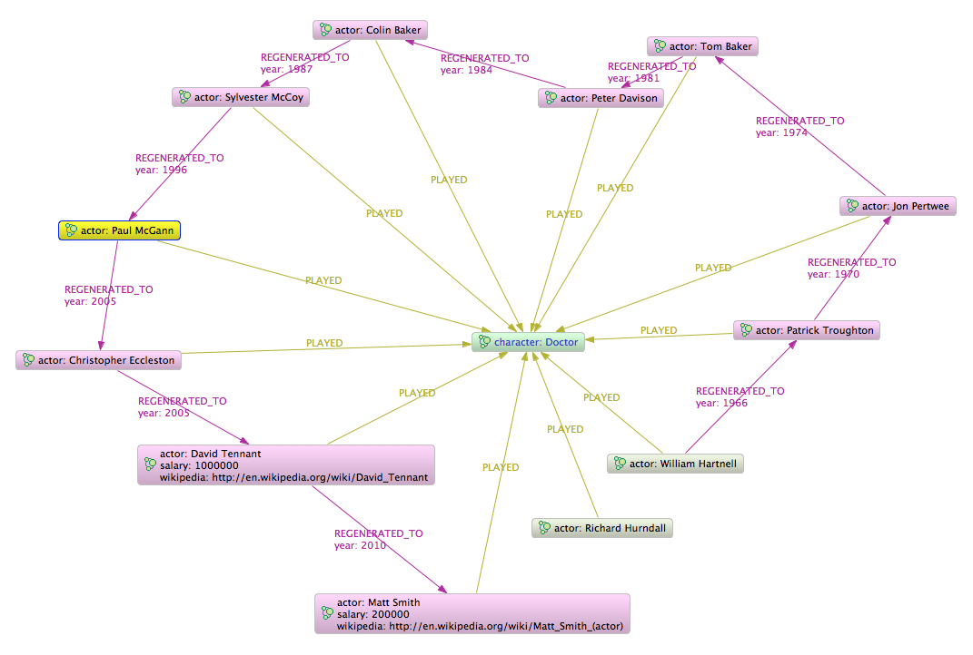
The Doctor

Slide 110
Koan 8
The Cypher Query Language

Slide 111
What is Cypher?
Declarative graph pattern matching language
“SQL for graphs”
Tabular results
Cypher is evolving steadily
Features added/refined each release
Supports queries
Including aggregation, ordering and limits
Mutating operations since 1.8 M01

Slide 112
Something new?
Existing Neo4j query mechanisms favour developers
Java API
Not ops-friendly

Slide 113
Cypher is Declarative
Imperative
follow relationship
breadth-first vs depth-first
explicit algorithm
Declarative
specify starting point
specify desired outcome
algorithm adaptable
based on query

Slide 114
Cypher is a pattern matching language
A
B
C

Slide 115
Un-named Nodes & Rels
() --> ()

Slide 116
Un-named Relationship
A
B
(A) --> (B)

Slide 117
ASCII Art Patterns
A
B
LOVES
A -[:LOVES]-> B

Slide 118
ASCII Art Patterns
A
B
C
A --> B --> C

Slide 119
ASCII Art Patterns
A
B
C
A --> B --> C, A --> C
A --> B --> C <-- A

Slide 120
Variable Length Paths
A
B
A
B
A
B
A -[*]-> B

Slide 121
Design Decisions
Optional relationships
A
B
A -[?]-> B

Slide 122
SQL Familiarity
select
from
where
group by
order by
start
match
where
return

Slide 123
Using Indexes
Key = ‘value’
Lookup:
start daleks = node:species(species='Dalek')
return daleks
Query:
start monsters = node:species('species:S*n')
return monsters
Index name
Lucene query string

Slide 124
Match (ASCII art for graphs)
Bound node
start daleks = node:species(species='Dalek')
match daleks-[:APPEARED_IN]->episode
return episode
Bound node
Relationship name
Direction

Slide 125
‘Circles and arrows’
Optional brackets
start daleks = node:species(species='Dalek')
match (daleks)-[:APPEARED_IN]->(episode)
return episode

Slide 126
Direction.BOTH
start daleks = node:species(species='Dalek')
match (daleks)-[:APPEARED_IN]-(episode)
return episode
No direction arrow

Slide 127
Example Query
Start node from index
The top 5 most frequently appearing companions:
start doctor=node:characters(character = 'Doctor')
match (doctor)<-[:COMPANION_OF]-(companion)
-[:APPEARED_IN]->(episode)
return companion.character, count(episode)
order by count(episode) desc
limit 5
Subgraph pattern
Accumulates rows by episode
Limit returned rows

Slide 128
Results
+--------------------------------------+
| companion.character | count(episode) |
+--------------------------------------+
| "Rose Tyler" | 30 |
| "Amy Pond" | 26 |
| "Sarah Jane Smith" | 22 |
| "Jamie McCrimmon" | 21 |
| "Tegan Jovanka" | 20 |
+--------------------------------------+

Slide 129
Shell
neo4j-sh (0)$ start doctor=node:characters(character='Doctor') match (doctor)<-[:COMPANION_OF]-(companion)-[:APPEARED_IN]->(episode) return companion.name, count(episode) order by count(episode) desc limit 5
+--------------------------------------+
| companion.character | count(episode) |
+--------------------------------------+
| "Rose Tyler" | 30 |
| "Amy Pond" | 26 |
| "Sarah Jane Smith" | 22 |
| "Jamie McCrimmon" | 21 |
| "Tegan Jovanka" | 20 |
+--------------------------------------+

Slide 130
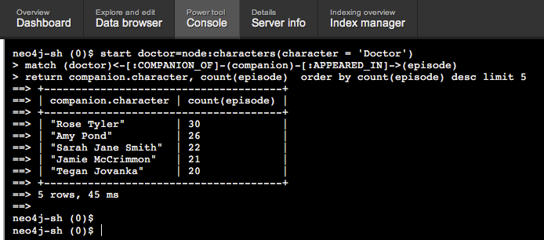
Webadmin Console

Slide 131
Code
ExecutionEngine engine = new ExecutionEngine(database);
String cql = "start doctor=node:characters(character='Doctor')"
+ " match (doctor)<-[:COMPANION_OF]-(companion)"
+ "-[:APPEARED_IN]->(episode)"
+ " return companion.character, count(episode)"
+ " order by count(episode) desc limit 5";
ExecutionResult result = engine.execute(cql);

Slide 132
Code
ExecutionEngine engine = new ExecutionEngine(database);
String cql = "start doctor=node:characters(character='Doctor')"
+ " match (doctor)<-[:COMPANION_OF]-(companion)"
+ "-[:APPEARED_IN]->(episode)"
+ " return companion.character, count(episode)"
+ " order by count(episode) desc limit 5";
ExecutionResult result = engine.execute(cql);
Top tip: ExecutionResult.dumpToString() is your best friend

Slide 133
Production Note: Parameterised Queries
Can avoid parsing/execution plan generation for repeated similar queries using parameters
Map<String, Object> params = new HashMap<String, Object>();
params.put( "regex", "S.*n" );
ExecutionResult result = engine.execute( "start n=node(0,1,2) " +
"where n.name =~ {regex} return n.name", params );
Notes:
Can use:
Lists
Literals
Regexps
Can use parameters in:
START
WHERE
Aggregate functions

Slide 134
Cypher’s awesome match syntax provides a natural bridge to your domain and domain experts

Slide 135
ASCII Art Queries!
character: Doctor
-[:PLAYED]->
actor: ???
species: Cyberman
-[:APPEARED_IN]->
<-[:APPEARED_IN]-
episode: ???
title: ???

Slide 136
ASCII Art Queries!
(Doctor)
-[:PLAYED]->
(Actor)
(Cyberman)
-[:APPEARED_IN]->
<-[:APPEARED_IN]-
(Episode)

Slide 137
ASCII Art Queries!
match (doctor)<-[:PLAYED]-(actor) -[:APPEARED_IN]->(ep) <-[:APPEARED_IN]-(cybermen)

Slide 138
Exercise 8a
Let’s create some graphs!
Focus on CREATE clause
Create an empty node
CREATE n
Create a node with some properties
CREATE n = { name : 'Joe', age : 21 }
Create some nodes and relations
CREATE clause can specify both nodes and relationships
CREATE a = { name : 'Amy' }, b = { name: 'Rory' },
a–[:LIKES]->b

Slide 139
WHERE clause
START doctor=node:characters(name = 'Doctor')
MATCH (doctor)<-[:PLAYED]-(actor)-[:APPEARED_IN]->(episode)
WHERE actor.actor = 'Tom Baker'
and episode.title =~ /.*Dalek.*/
RETURN episode.title

Slide 140
Exercise 8b
Focus on the MATCH clause, indexes as starting points
Anonymous nodes ()
Firstly, just find and return the Doctor
Count the number of episodes
Use the episodes index only
Find episodes where the Cybermen appeared
Find episodes where Rose Tyler and David Tennant’s Doctor battled the Daleks
Find all the Doctor’s friend and enemies
Multiple relationship types permitted in MATCH clause
Use the WHERE clause to filter within a MATCH

Slide 141
Aggregation
Aggregation:
COUNT, SUM, AVG, MAX, MIN, COLLECT
Ordering:
ORDER BY <property>
ORDER BY <property> DESC

Slide 142
Exercise 8c
Focus on the RETURN clause, property access and aggregate functions
Find the wikipedia entries for those characters that have them
Optional properties: node.property?
Find how many actors have played the Doctor
Count rows with COUNT
Alias columns with AS
Find the first and latest year where the Doctor regenerated
Count rows with MIN and MAX
Find the first episode where Freema Agyeman and David Tennant worked together
Use MIN
Compute the average salary for actors who played the Doctor
Optional property salary? And use AVG
List the enemies in each episode of Peter Davison’s Doctor
Use the COLLECT function to create lists
Use ORDER BY to sort results
Ascending by default
Find the enemy species that Rose Tyler fought
Many duplicates, so use the DISTINCT function
Use WHERE to filter for species only
Use HAS to filter for nodes with a species property

Slide 143
Exercise 8d
Focus on the DELETE clause, in combination with what we’ve learned before
Can DELETE nodes, relationships, properties
Remember nodes cannot be removed while they’re connected to the graph
You’ve got to:
Kill Kirk again, this time in Cypher
Remove salary data of the Doctor actors

Slide 144
Exercise 8e
Focus on longer MATCH clause and aggregation functions
Find the most recent regeneration year
Use MAX
Find the hardest working prop parts (shoulder/skirt) in the original series
Use COUNT and LIMIT

Slide 145

Dalek Props
Shoulders
(Proper nerds)
(Proper nerds)
(Proper nerds)
Skirt

Slide 146




species:Dalek
APPEARED_IN
title:Power of
the Daleks
USED_IN
props:Daleks
MEMBER_OF
MEMBER_OF
name:Dalek Six-5
name:Dalek 1
name:Dalek 2
name:Dalek 7
type:shoulders
type:skirt

Slide 147
name:Dalek 1
name:Dalek 2
name:Dalek 7
name:Dalek Six-5
ORIGINAL_PROP
ORIGINAL_PROP
ORIGINAL_PROP
ORIGINAL_PROP
name:Dalek 6
name:Dalek 5

Slide 148






title:The Dalek Invasion of Earth
title:Power of
the Daleks
title:The Daleks
name:
Dalek Six-5
name:Dalek 1
name:Dalek 2
name:Dalek 7
name:Dalek Two-1
name:Dalek One-5
name:Dalek Six-7

Slide 149

Cypher Query
START daleks=node:species(species='Dalek')
MATCH daleks-[:APPEARED_IN]->episode<-[:USED_IN]-
()<-[:MEMBER_OF]-()-[:COMPOSED_OF]->
part-[:ORIGINAL_PROP]->originalprop
RETURN originalprop.name, part.type, COUNT(episode)
ORDER BY COUNT(episode) DESC
LIMIT 1

Slide 150
Index Lookup
START daleks=node:species(species='Dalek')
MATCH daleks-[:APPEARED_IN]->episode<-[:USED_IN]-
()<-[:MEMBER_OF]-()-[:COMPOSED_OF]->
part-[:ORIGINAL_PROP]->originalprop
RETURN originalprop.name, part.type, COUNT(episode)
ORDER BY COUNT(episode) DESC
LIMIT 1

Slide 151
Match Nodes & Relationships
START daleks=node:species(species='Dalek')
MATCH daleks-[:APPEARED_IN]->episode<-[:USED_IN]-
()<-[:MEMBER_OF]-()-[:COMPOSED_OF]->
part-[:ORIGINAL_PROP]->originalprop
RETURN originalprop.name, part.type, COUNT(episode)
ORDER BY COUNT(episode) DESC
LIMIT 1

Slide 152
MATCH daleks-[:APPEARED_IN]->episode<-[:USED_IN]-
()<-[:MEMBER_OF]-()-[:COMPOSED_OF]->
part-[:ORIGINAL_PROP]->originalprop
APPEARED_IN
daleks
episode
USED_IN
MEMBER_OF
COMPOSED_OF
ORIGINAL_PROP
part
originalprop

Slide 153
Return Values
START daleks=node:species(species='Dalek')
MATCH daleks-[:APPEARED_IN]->episode<-[:USED_IN]-
()<-[:MEMBER_OF]-()-[:COMPOSED_OF]->
part-[:ORIGINAL_PROP]->originalprop
RETURN originalprop.name, part.type, COUNT(episode)
ORDER BY COUNT(episode) DESC
LIMIT 1

Slide 154

The Dalek Props

Slide 155
Exercise 8f
Focus on processing paths with Cypher
Find how many times the Doctor regenerated between Tom Baker and Christopher Eccleston
Use LENGTH
Constrain the path to REGENERATES_TO relationships
Find the longest continuous story arc with the Master
Hint: number of path hops = number of episodes -1
Use nested WHERE clause, ALL and NODES()

Slide 156
Variable Path Lengths
MATCH path = (episode)-[:NEXT*]->()
MATCH path = (episode)-[:NEXT*1..5]->()

Slide 157
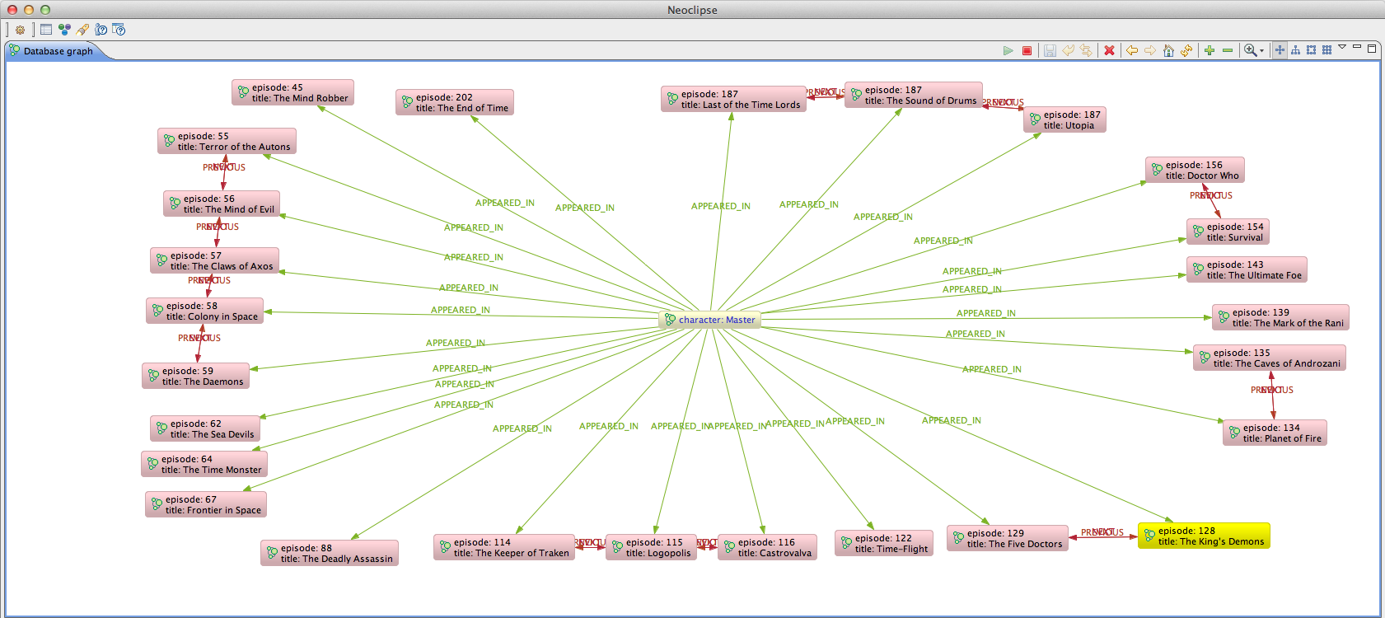

Slide 158
Exercise 8g
Focus on calling graph algorithms from Cypher
Find how many episodes there have been
Hint: episode numbers are strange
Use shortestPath algorithm
And the LENGTH function

Slide 159
Koan 9
Graph Algorithms

Slide 160
Graph Algos
Payback time for Algorithms 101
Graph algos are a higher level of abstraction
You do less work!
The database comes with a set of useful algorithms built-in
Time to get some payback from Algorithms 101
Notes:
We’ve seen some of the graph algorithms already when we called them from Cypher.
Neo4j has a rich set of such algorithms that can be called through the JVM and REST APIs.

Slide 161
The Doctor versus The Master
The Doctor and the Master been around for a while
But what’s the key feature of their relationship?
They’re both timelords, they both come from Gallifrey, they’ve fought

Slide 162
Try the Shortest Path!
What’s the most direct path between the Doctor and the Master?
Node theMaster = …
Node theDoctor = …
int maxDepth = 5;
PathFinder<Path> shortestPathFinder = GraphAlgoFactory.shortestPath( Traversal.expanderForAllTypes(), maxDepth);
Path shortestPath =
shortestPathFinder.findSinglePath(theDoctor, theMaster);
Notes:
The Doctor and the Master are connected by many possible paths
- Both Timelords (species)
- Both from Gallifrey
- Both visited Earth
- Both own tardises
- Both enemies of each other is the shortest path though, and it defines the most important characteristic of their relationship
No more than depth 5, or we find Kevin Bacon!
Turns out a single relationship ENEMY_OF is the shortest path, and this defines the most important interaction between the Doctor and the Master

Slide 163

Path finding
Find all the episodes where Rose Tyler fought the Daleks

Slide 164
Path finder code
algo
Node rose = ...
Node daleks = ...
PathFinder<Path> pathFinder = GraphAlgoFactory.pathsWithLength( Traversal.expanderForTypes( DoctorWhoRelationships.APPEARED_IN, Direction.BOTH), 2);
Iterable<Path> paths = pathFinder.findAllPaths(rose, daleks);
constraints
fixed path length

Slide 165
Exercise
Find episodes where Rose Tyler fought the Daleks
Find how many times the Master has regenerated
Compare this to how we did it with traversers!
Find the episode where David Tennant’s Doctor regenerated into Matt Smith’s

Slide 166

The Master

Slide 167

The Doctor Regenerates
Notes:
Side note: in graph theory this is phenomenon is well known, it’s called a triadic closure.
In this case because both Matt Smith and David Tennant appear in an episode forming two sides of a triangle, there’s a natural tendency to want to close the third side.
So graph theory could predict the regeneration simply by the shape of the existing network. This is a general property, not something Doctor Who specific, and shows how great graphs are for analysing data – the fundamental mathmatical tools are well known, well understood, and widely applicable.

Slide 168
Koan 10
Graph Matching

Slide 169
Why graph matching?
Same powerful model as Cypher: looking for patterns in a data set
E.g. retail analytics
Higher-level abstraction than raw traversers
You do less work!
Lower-level than Cypher
You can drop into Java to do things Cypher can’t

Slide 170
Graph Matchers
Library: neo4j-graph-matching
<dependency org="org.neo4j" name="neo4j-graph-matching" rev="0.8"/>
https://github.com/neo4j/graph-matching
Uses PatternNode and PatternRelationship types to describe graph patterns
The “unbound” parts of the graph

Slide 171

In which episodes did the Doctor battle the Cybermen?

Slide 172
Setting up and matching a pattern
final PatternNode theDoctor = new PatternNode();
theDoctor.setAssociation(universe.theDoctor());
final PatternNode anEpisode = new PatternNode();
anEpisode.addPropertyConstraint("title", CommonValueMatchers.has());
anEpisode.addPropertyConstraint("episode", CommonValueMatchers.has());
final PatternNode aDoctorActor = new PatternNode();
aDoctorActor.createRelationshipTo(theDoctor, DoctorWhoUniverse.PLAYED);
aDoctorActor.createRelationshipTo(anEpisode, DoctorWhoUniverse.APPEARED_IN);
aDoctorActor.addPropertyConstraint("actor", CommonValueMatchers.has());
final PatternNode theCybermen = new PatternNode();
theCybermen.setAssociation(universe.speciesIndex.get("species", "Cyberman").getSingle());
theCybermen.createRelationshipTo(anEpisode, DoctorWhoUniverse.APPEARED_IN);
theCybermen.createRelationshipTo(theDoctor, DoctorWhoUniverse.ENEMY_OF);
PatternMatcher matcher = PatternMatcher.getMatcher();
final Iterable<PatternMatch> matches = matcher.match(theDoctor, universe.theDoctor());

Slide 173
Exercise
Find Doctor versus Cybermen Episodes
See previous slide
Find the Doctors that battled the Cybermen
Not all of them did
Find the episodes with Rose Tyler and the Ninth Doctor

Slide 174

Rose and the Ninth Doctor

Slide 175
Koan 11
REST API: Client Side

Slide 176
REST API
The only way to access the server today
Binary protocol part of the product roadmap
JSON is the default format
Remember to include these headers:
Accept:application/json
Content-Type:application/json

Slide 177
Example
curl http://localhost:7474/db/data/node/1
{
"outgoing_relationships" : "http://localhost:7474/db/data/node/1/relationships/out",
"data" : {
"character" : "Doctor"
},
"traverse" : "http://localhost:7474/db/data/node/1/traverse/{returnType}",
"all_typed_relationships" : "http://localhost:7474/db/data/node/1/relationships/all/{-list|&|types}",
"property" : "http://localhost:7474/db/data/node/1/properties/{key}",
"self" : "http://localhost:7474/db/data/node/1",
"properties" : "http://localhost:7474/db/data/node/1/properties",
"outgoing_typed_relationships" : "http://localhost:7474/db/data/node/1/relationships/out/{-list|&|types}",
"incoming_relationships" : "http://localhost:7474/db/data/node/1/relationships/in",
"extensions" : {
},
"create_relationship" : "http://localhost:7474/db/data/node/1/relationships",
"all_relationships" : "http://localhost:7474/db/data/node/1/relationships/all",
"incoming_typed_relationships" : "http://localhost:7474/db/data/node/1/relationships/in/{-list|&|types}"
}

Slide 178
Batches
Tunnel commands, all run within a single transaction
On error, whole transaction rolled back
HTTP status code appropriate to the command that caused the error
Useful feedback in the response body

Slide 179
Batch Example
POST http://localhost:7474/db/data/batch
Accept: application/json
Content-Type: application/json
[{
"method" : "PUT",
"to" : "/node/0/properties",
"body" : {
"age" : 1
},
"id" : 0
},
{
"method" : "GET",
"to" : "/node/0",
"id" : 1
},
{
"method" : "POST",
"to" : "/node",
"body" : {
"age" : 1
},
"id" : 2
}]

Slide 180
Paged Traversers
Each node/relationship representation contains a link to a paged traverser
Send your traverser there, and it will be held server-side
For a while, until its lease expires
And the results will be delivered in pages
You set the size

Slide 181
Creating a Paged Traverser
POST http://localhost:7474/db/data/node/34/paged/traverse/node
Accept: application/json
Content-Type: application/json
{"prune_evaluator":{"language":"builtin","character":"none"},"return_filter":{"language":"javascript","body":"position.endNode().getProperty('name').contains('1');"},"order":"depth_first","relationships”:{"type":"NEXT","direction":"out”}}

Slide 182
Response
201 Created
Content-Type: application/json
Location: http://localhost:7474/db/data/node/34/paged/traverse/node/bd02bb8adf4145afbbc725ed872a2e32
[
... first page of results
]

Slide 183
Paging Results
GET http://localhost:7474/db/data/node/34/paged/traverse/node/bd02bb8adf4145afbbc725ed872a2e32
Accept: application/json
200 OK
Content-Type: application/json
Location: http://localhost:7474/db/data/node/34/paged/traverse/node/bd02bb8adf4145afbbc725ed872a2e32
[
... next (partial) page of results
]
404 Not Found

Slide 184
Exercise
Count the Doctor’s enemies
Just count relationships
Identify which of the Doctors took part in invasion stories
Use a Javascript traversal description
Create regenerations for early Doctors
Hypermedia-driven interaction

Slide 185

Adding Incarnations

Slide 186
Koan 12
REST API: Unmanaged Extensions

Slide 187
What are Unmanaged Extensions?
Allow arbitrary code to be deployed in the server
Use to support domain-specific REST APIs in the Neo4j server
Not just nodes and relationships
Sharp tool – be careful what you expose!
E.g. System.exit(…)

Slide 188
How to use Unmanaged Extensions
Uses JAX-RS
Access to the server’s GraphDatabaseService given through @Context annotation
Any method/constructor parameter
Packages containing extensions must be registered (comma-separated) in config:
org.neo4j.server.thirdparty_jaxrs_classes= org.example.rest,org.neo4j.examples, com.foo.bar.tests

Slide 189
Exercise
Create a traversal or Cypher query to find home planets for characters, and expose it via HTTP GET
Use @Context, @Context, @PathParam, @GET from JAX-RS
URI template: /{character}/homeplanet

Slide 190
Koan 13
REST API: Managed Plugins

Slide 191
About Managed Plugins
Built-in framework, produces JSON and HTML
Extend the capabilities of the existing REST API
Add links to node or relationship representations
"extensions" : {
"AwesomenessServerPlugin" : {
"level" :
"http://localhost:7474/db/data/ext/AwesomenessServerPlugin/node/1/level"
}
}
Notes:
In IntelliJ, the META-INF/services/org.neo4j.plugins.ServerPlugin file will also need to be added to the list of compiler resources as well as market as a source root.
Go to the Preferences > Compiler menu and add it into the semi-colon separated list of compiler resources.
In Eclipse just adding it as source folder is enough.
The Ant build file does the right thing on the command line.

Slide 192
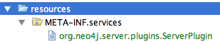
Registering Managed Plugins
Each plugin must be registered with the Java ServiceLoader
In META-INF/services/org.neo4j.plugins.ServerPlugin
List each plugin by fully qualified class name
org.neo4j.tutorial.MyPlugin
Notes:
In IntelliJ, the META-INF/services/org.neo4j.plugins.ServerPlugin file will also need to be added to the list of compiler resources as well as market as a source root.
Go to the Preferences > Compiler menu and add it into the semi-colon separated list of compiler resources.
In Eclipse just adding it as source folder is enough.
The Ant build file does the right thing on the command line.
In this koan, we take care of registration for you

Slide 193
Targeting Extensions
Extensions are bound and advertised in links through targeting
Targets can be: Node, Relationship, GraphDatabaseService
@PluginTarget
Source also needed for data
@Source
Descriptions can be placed liberally – they appear in the GET-able description
@Description

Slide 194
Activating Managed Extensions
Description available via GET
Activated via POST
Parameters specified in GET response

Slide 195
Exercise
The Doctor Who universe is full of awesome, so each node should be extended to provide an “awesomeness rating” on demand
The awesomeness rating engine is provided:
org.neo4j.tutorial.AwesomenessRatingEngine
Based on proximity to the Doctor

Slide 196
Koan 14
REST API: Security

Slide 197
Security
Neo4j server runs on port 7474
By default will only serve requests to localhost
Edit conf/neo4j-server.properties to allow any host
org.neo4j.server.webserver.address=0.0.0.0
Notes:
http://docs.neo4j.org/chunked/snapshot/security-server.html

Slide 198
Security Rules
Deals with HTTP request authorisation
Each request to the server can be passed through a pipeline of user-defined security rules
Rules registered as comma-separated property in conf/neo4j-server.properties
org.neo4j.server.rest.security_rules=org.neo4j.PasswordRule
Notes:
http://docs.neo4j.org/chunked/snapshot/security-server.html

Slide 199
Key Interface
org.neo4j.server.rest.security.SecurityRule
boolean isAuthorized(HttpServletRequest request);
String forUriPath();
String wwwAuthenticateHeader();
Notes:
isAuthorized determines whether or not the rule passed
forUriPath declares the URI space for which the rule should be evaluated
wwwAuthenticateHeader provides metadata for a 401 response if the rule fails to authorise access to the database

Slide 200
Exercise
The SalaryUnmanagedExtension is registered at /{actor}/salary
It needs to be protected with a SecurityRule: UserNameAndPasswordForSalariesSecurityRule
You have to implement that rule so that the (functional) tests pass
Only secure this part of the API
Simple (insecure) username/passwords
401 response for failed attempts

Slide 201
Ops and Big Data
Neo4j in Production, in the Large

Slide 202
Two Challenges
Operational considerations
Data should always be available
Scale
Large dataset support

Slide 203
Neo4j HA
The HA component supports master-slave replication
For clustering
For DR across sites
Notes:
The HA component uses log shipping under the covers to ensure eventual consistency across database instances
We use Zookeeper to elect cluster masters, even in the event of failure/partition (PAXOS algorithm)

Slide 204
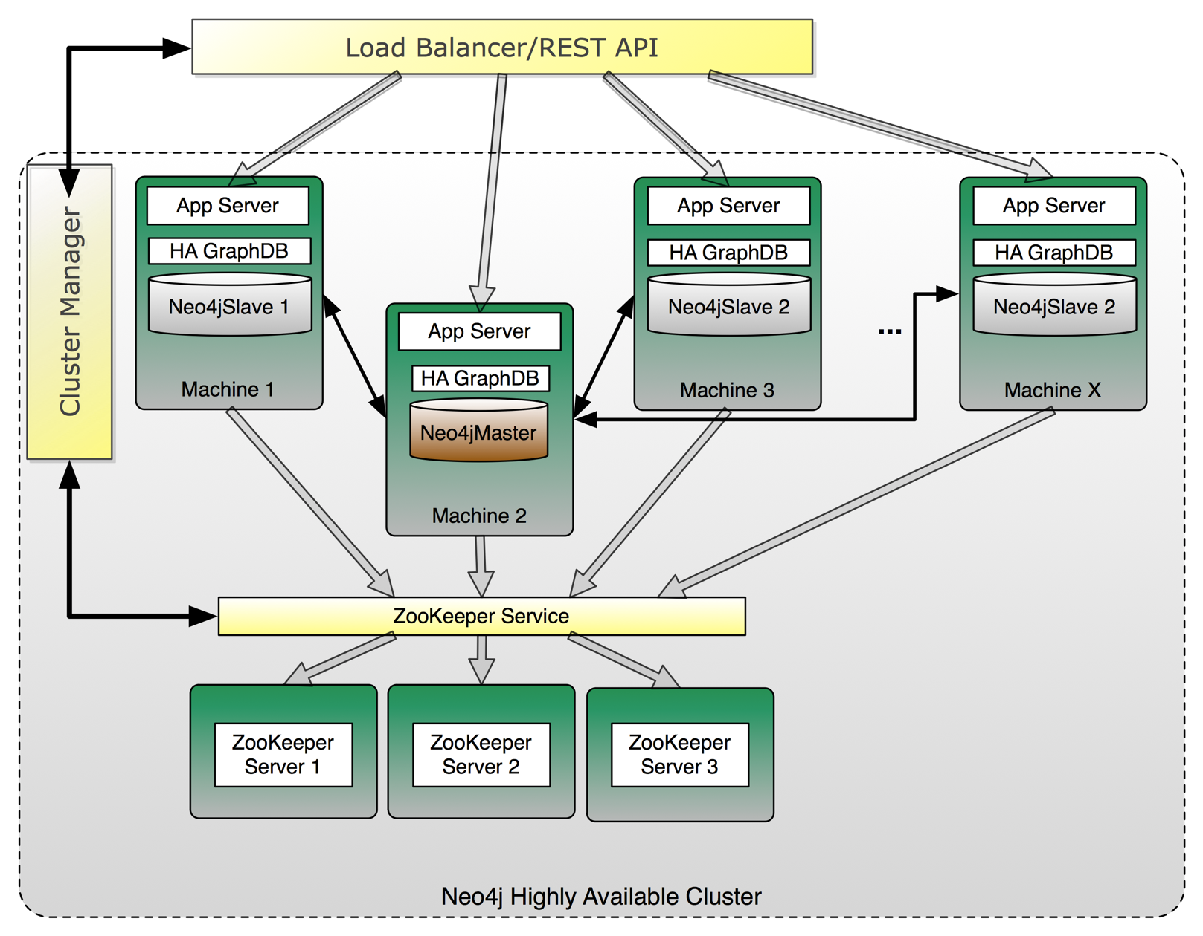
HA Architecture

Slide 205

Write to a Master
Writes to the master are fast
And slaves eventually catch up
Notes:
Slaves poll master for transactions they haven’t yet applied.
Polling interval is configurable per slave

Slide 206

Write to a Slave
Writes to a slave cause a synchronous transaction with the master
And the other slaves eventually catch up

Slide 207
So that’s local availability sorted, now we need Disaster Recovery

Slide 208
HA at Large Geographic Scale
DC_{USA}
DC_{EU}
DC_{AsiaPac}
HA_{master}
HA_{pslave}
HA_{pslave}
HA_{slave}
HA_{pslave}
HA_{pslave}
HA_{slave}
HA_{pslave}
HA_{pslave}
Notes:
Some slaves can be made always slave only – they’ll never try to become master in the event of failover.
This means we can keep a master in a particular data centre – unless there’s a disaster when we can ask one of the perma-slaves to become master, and the other perma-slaves to become regular slaves.
Perma-slaves can be used to scale out reads local to users in a global deployment – this is how some large corporate customers work atop Amazon EC2.

Slide 209
DC Catastrophe only causes movement of master
DC_{USA}
DC_{EU}
DC_{AsiaPac}
HA_{master}
HA_{master}
HA_{pslave}
HA_{slave}
HA_{slave}
HA_{pslave}
HA_{slave}
HA_{slave}
HA_{pslave}
Notes:
Lose capacity, not entire service – graceful degredation

Slide 210
But what about backup?

Slide 211

Any instance in a HA cluster can be used for backup
DC_{USA}
DC_{EU}
DC_{AsiaPac}
HA_{master}
HA_{pslave}
HA_{pslave}
HA_{slave}
HA_{pslave}
HA_{pslave}
HA_{slave}
HA_{pslave}
HA_{pslave}

Slide 212
Any instance in a HA cluster can be used for backup
DC_{USA}
DC_{EU}
DC_{AsiaPac}
HA_{master}
HA_{pslave}
HA_{pslave}
HA_{slave}
HA_{pslave}
HA_{pslave}
HA_{slave}
HA_{pslave}
HA_{pslave}

Slide 213
Scaling graphs is hard
Notes:
Not all databases need to be Facebook scale.
Most enterprise deployments have much more modest usage.

Slide 214

“Black Hole” server
Notes:
The black-hole problem: popular nodes get lumped together on a single instance, but there is low point cut

Slide 215

Chatty Network
Notes:
Load-leveling alone can lead to many relationships crossing instances.
These are very expensive to traverse, networks are many orders of magnitude slower than in-memory traversals

Slide 216

Minimal Point Cut
Notes:
There are well-known algorithms that help with keeping graphs balanced (the Minimum Point-Cut problem)
They can work at
- insert-time
- periodically
Each has different properties, but good ones take a local view of the graph (no global locks) and work incrementally (short bursts).
They can even take into account use patterns.
But this is still an open research area. Graphs are highly mutable and so these algorithms face an uphill fight, even if we could get them right.
Unlike other NoSQL stores, graph’s simply aren’t predictable, and so we can’t use techniques like consistent hashing for scale out.

Slide 217
So how do we scale Neo4j?
Notes:
Not all databases need to be Facebook scale.
Most enterprise deployments have much more modest usage.

Slide 218
Neo4j Logical Architecture
REST API
Java
Ruby
…
Clojure
JVM Language Bindings
Graph Matching
Core API
Traversal Framework
Caches
Memory-Mapped (N)IO
Filesystem
Notes:
Filesystem:
- files on disk.
- We lay them out very carefully so that we can calculate offsets and jump to any record in the files quickly.
- We love SSDs because we can still get stung by spinning disks at this level, but in a second I’ll show how we alleviate that.
- We have separate stores for nodes, relationships, properties, and optimisations for common cases to ensure that data is found in one file (e.g. short strings)
Memory-mapped NIO. We use Java NIO, which is fast!
Caches:
- Our special sauce. Caches allow us to work fast even with spinning disks – they give us millions of traversals per second on laptop-quality hardware
Core API:
- Low level graph abstractions, imperative in nature. Can be highly efficient
- Trade off is low-level programming
Traversal Framework:
- The “query layer”
- We have one stable and one experimental version
- Declaratively describe what to look for in a graph, not so much how.
JVM Language bindings:
- Remember we’re a Java database, so anything can bind to us. We have a Java API, that API has been consumed and adapted to suit JRuby, Jython, Clojure, Scala, etc
REST API:
- A proper, discoverable, hypermedia-driven REST API. Useful if you’re off the JVM or just want to treat the database as a server on the network

Slide 219
A Humble Blade
Blades are powerful!
A typical blade will contain 128GB memory
We can use most of that
If O(dataset) ≈ O(memory) then we’re going to be very fast
Remember we can do millions of traversals per second if the caches are warm
Notes:
10s of gigabytes:
Slam in the RAM on a single server and all is plain sailing
It is write scaling that is trickier with graphs, but if you’ve got an enterprise-scale or read-mostly web-scale system this might not be such a problem

Slide 220
Cache Sharding
A strategy for coping with large data sets
Terabyte scale
Too big to hold all in RAM on a single server
Not too big to worry about replicating it on disk
Use each blade’s main memory to cache part of the dataset
Try to keep caches warm
Full data is replicated on each rack

Slide 221

Consistent Routing
Notes:
Consistent Routing c.f. Consistent hashing name – means always try to route related requests to the same server to hopefully benefit from warm caches

Slide 222
Domain-specific sharding
Eventually (Petabyte) level data cannot be replicated practically
Need to shard data across machines
Remember: no perfect algorithm exists
But we humans sometimes have domain insight
Notes:
Some domains naturally shard.
E.g. geo where the connections between cities are few compared with the connections within the cities. So can place cities or countries on different nodes
E.g. user content, where connections between normal users are few (modulo any celebrities).
Write-scaling is not automatic with graphs

Slide 223
Deployment architectures

Slide 224
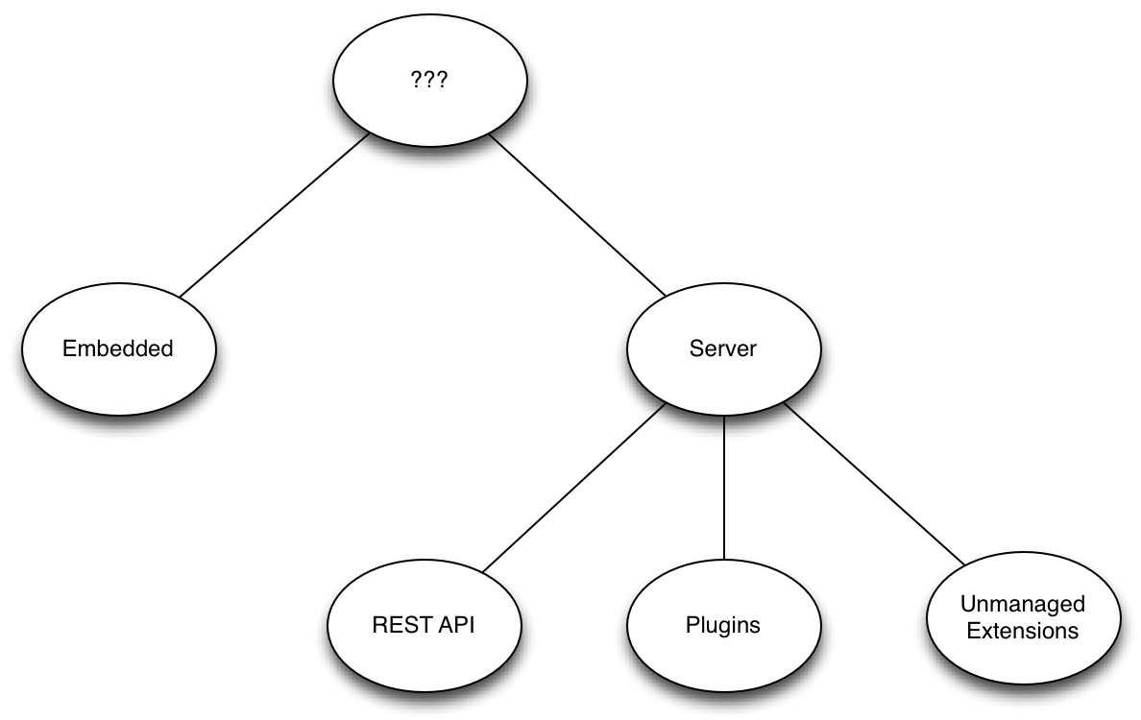
Technical Architecture Decisions

Slide 225
Embedded
Pros
Speed: no network calls
APIs: core APIs, traversers, Cypher
Easy to write functional tests: just inject GraphDatabaseAPI
Can still use HA
Cons
Java (or JVM language) only
Application responsible for controlling database lifecycle
Application GC pauses can slow down queries and disrupt HA
Number of instances tied to number of app servers
Notes:
Nodes
Documents, name-value pairs
Relationships
Named
Directed – for semantic clarity
BUT traversable in any direction
Can also contain nodes

Slide 226
Server
Pros
Accessible from multiple client platforms
Protected from bad client behaviors (e.g. GC pauses)
Can load balance read and write traffic
Cons
Must still tune heap for traverser and serialization garbage
Functional tests require server instance
REST API can be cumbersome
Notes:
Nodes
Documents, name-value pairs
Relationships
Named
Directed – for semantic clarity
BUT traversable in any direction
Can also contain nodes

Slide 227
HA – Writing Through Master
Pros
Best performance; throughput and latency
Cons
Inconsistency window (write committed on master, not yet replicated to slaves); master re-election during this period will rollback writes

Slide 228
HA – Writing Through Slaves
Pros
Change made durable on two instances, not one
Less chance of rollback: in case of master re-election, slave with most recent TxId will be elected master
Cons
High network traffic overhead
Order-of-magnitude reduced performance
Notes:
Nodes
Documents, name-value pairs
Relationships
Named
Directed – for semantic clarity
BUT traversable in any direction
Can also contain nodes

Slide 229
HA Recommendations
Do not write through slaves
Performance impact
For increased durability, use ha.tx_push_factor with value 1 or more
In server environment, use ‘write’ load balance, which directs to master, and ‘read’ load balancer

Slide 230
REST API
Pros
Named links instruct the client what to do next; bind to the names, not the URI structures
Batch API, Cypher queries
Good for discovering and navigating the graph
Cons
Chatty; don’t use it for traversing the API node-by-node
Verbose; lots of links per response
No control over format; JSON or HTML only
Uses graph language throughout; results describe nodes and relationships

Slide 231
Plugins
Pros
Server-side scripts for retrieving/manipulating nodes, relationships, paths, properties or indices
Server infrastructure takes care of content negotiation and response formatting
Cons
Limited power; not a full Web API
Uses graph language throughout; results describe nodes and relationships

Slide 232
Unmanaged Extensions
Pros
Encapsulate arbitrarily complex Units of Work
Full control over HTTP response
Allows server to talk ‘your domain’, rather than graph
Cons
Sharp tool; careless coding can harm server
Requires knowledge of JAX-RS

Slide 233
Recommended Architecture
Server
Scale independently of application
Client platform independent
Not subject to application garbage
Load balance writes to master, reads to slaves
Unmanaged extensions
Fine-grained control over representation formats
Encapsulate Unit of Work in Tx boundary
Can be unit tested independent of server
If using GET, and all query params are in URI, can use HTTP caching

Slide 234
Testing

Slide 235
Testing
Use tests to capture your understanding of your domain’s data model
Inject small, representative graphs to test individual traversals and operations
Use the tests to identify regressions as your data model evolves

Slide 236
Testing Embedded
Use EphemeralDatabase
In-memory
For testing purposes only
Included in the kernel test jar:
<dependency>
<groupId>org.neo4j</groupId>
<artifactId>neo4j-kernel</artifactId>
<version>1.8</version>
<type>test-jar</type>
<scope>test</scope>
</dependency>

Slide 237
private Database db;
@Before
public void setup() throws Throwable {
db = new EphemeralDatabase();
db.start();
populateDatabase( db.getGraph() );
}
@After
public void tearDown() throws Throwable {
db.stop();
}
@Test
public void shouldFindFriendsOfAFriend() {
FriendOfAFriendSearch search = new FriendOfAFriendSearch(db.getGraph());
Collection<String> foafs = search.findFoafsFor("ian");
assertThat(foafs, hasItems("emil", "peter", "michael"));
}
private void populateDatabase( GraphDatabaseAPI graph ) {
// Populate graph inside transaction
}
Unit testing embedded
Setup and teardown for each test
Inject into constructor of object under test

Slide 238
Testing Server
Use ServerBuilder to create a server
Start the server
Populate the database
Run test
Shutdown server

Slide 239
ServerBuilder
Utility class for building and configuring a server:
<dependency>
<groupId>org.neo4j.app</groupId>
<artifactId>neo4j-server</artifactId>
<version>1.8</version>
</dependency>
<dependency>
<groupId>org.neo4j.app</groupId>
<artifactId>neo4j-server</artifactId>
<version>1.8</version>
<type>test-jar</type>
</dependency>

Slide 240
Test
private CommunityNeoServer server;
@Before
public void setup() throws IOException {
server = ServerBuilder.server().build();
server.start();
db = server.getDatabase().getGraph();
populateDatabase( server.getDatabase().getGraph() );
}
@After
public void teardown() {
server.stop();
}
private void populateDatabase( GraphDatabaseAPI db ) {
Transaction tx = db.beginTx();
try {
// Populate database
}
finally {
tx.finish();
}
}
Starting a server with each test can be slow
Notes:
For some kinds of testing it may be possible to instantiate a server per fixture (test suite), using @BeforeClass and @AfterClass, rather than per test.

Slide 241
Unit Testing Managed Extensions
Unmanaged extensions are JAX-RS annotated classes
They can be tested just like components that use an embedded Neo4j instance
Inject the database using the @Context annotation
Use JAXB annotated DTOs for return values
Makes content negotiation easy
Notes:
Nodes
Documents, name-value pairs
Relationships
Named
Directed – for semantic clarity
BUT traversable in any direction
Can also contain nodes

Slide 242
JAXB annotated DTO
@XmlRootElement
public class Friends {
@XmlElement
private List<String> friends;
public Friends(){}
public Friends(List<String> friends) {
this.friends = friends;
}
public List<String> getValue(){
return friends;
}
}

Slide 243
Unmanaged extension
@Path("/{name}")
public class FriendOfFriendsUnmanagedExtension {
@GET
@Path("/foafs")
@Produces({MediaType.APPLICATION_JSON, MediaType.APPLICATION_XML})
public Friends findFoafsFor(@PathParam("name") String name,
@Context GraphDatabaseService db){
List<String> foafs = new FriendOfAFriendSearch(db)
.findFoafsFor(name);
return new Friends(foafs);
}
}
Inject graph database instance using @Context
Return DTO
Notes:
For convenience, here we’re using the FriendOfAFriendSearch component shown in a previous slide – but we could as easily execute our own traversal or Cypher query

Slide 244
private Database db;
@Before
public void setUp() throws IOException{
db = new EphemeralDatabase();
db.start();
populateDatabase( db.getGraph() );
}
@After
public void tearDown(){
db.shutdown();
}
@Test
public void shouldFindFriendsOfAFriend(){
FriendOfFriendsUnmanagedExtension extension =
new FriendOfFriendsUnmanagedExtension();
Friends friends = extension.findFoafsFor("ian", db.getGraph());
assertThat(friends.getValue(), hasItems("emil", "peter", "michael"));
}
private void populateDatabase( GraphDatabaseAPI graph ) {
// Populate graph inside transaction
}
Unit testing an extension
Inject graph database into method
Notes:
Very similar to testing any other component that uses embedded database. Differences:
Injecting database as method parameter, rather than through constructor
Returning a DTO

Slide 245
Data modelling

Slide 246
Data modelling
Nodes
Describe entities
Anything with its own identity
‘Complex’ value types – e.g. addresses
Relationships
Describe how one thing is related to another
Including relationships in time/space

Slide 247
Actions
Model actions as their product or output:
(Ian)-[:SENT]->(email)-[:TO]->(Jim)
NOT
(Ian)-[:EMAILED]->(Jim)

Slide 248
Entities are easily extended
(Ian)-[:SENT]->(email)-[:TO]->(Jim),
(email)-[:CC]->(Alistair),
(email)-[:HAS_ATTACHMENT]->(attachment)
(Ian)-[:WROTE]->(review)-[:OF]->(movie),
(review)-[:PUBLISHED_AT]->(Amazon)

Slide 249
Composition
Use HAS_A_XXX and BELONGS_TO_XXX relationships (or similar):
(Neo)<-[:BELONGS_TO_COMPANY]-(Ian),
(Ian)-[:HAS_A_HOME_ADDRESS]->(address)

Slide 250
Be specific
Avoid loading properties in traversals/matches. Prefer
[:HAS_HOME_ADDRESS]
over
[r:HAS_ADDRESS WHERE r.type = ‘Home’]
Neo4j supports 32,000 different relationship types

Slide 251
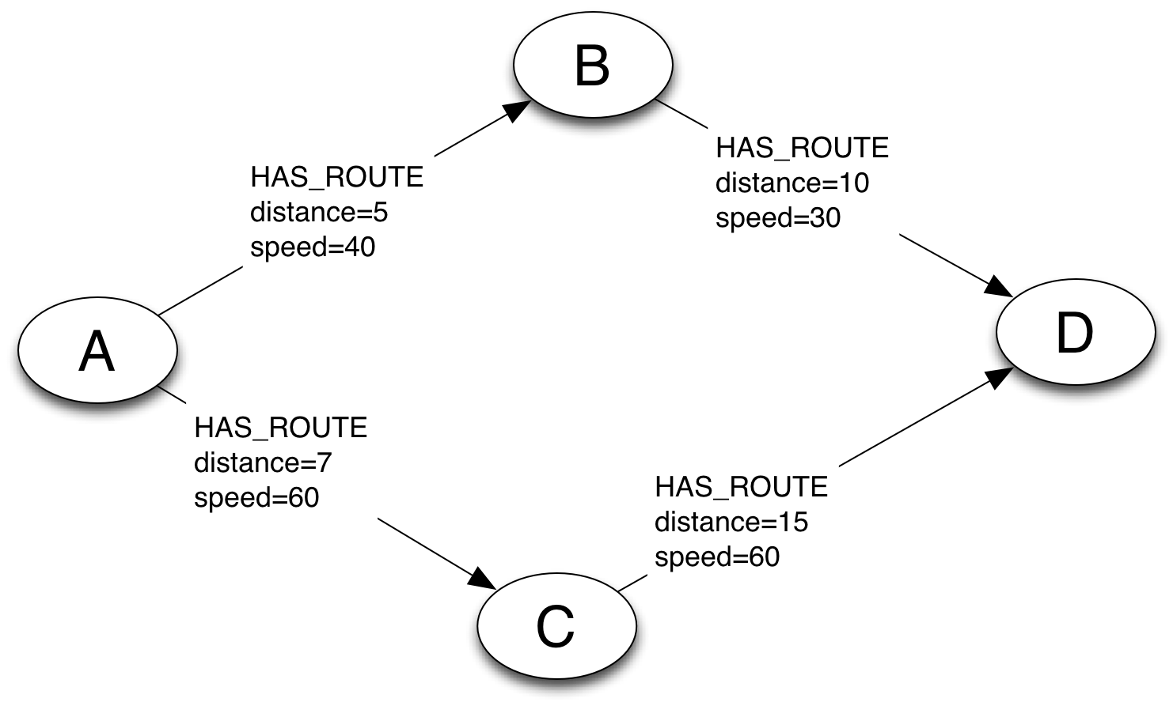
Relationship Properties
Use for weighted graph algorithms

Slide 252
Relationship or Node?
Is ‘Route’ a relationship or a node?
If it simply describes how 2 things (e.g. places) are related, it’s a relationship
If it is important as a thing in itself (associated, for example, with the companies maintaining or tolling it), then model it as a node

Slide 253
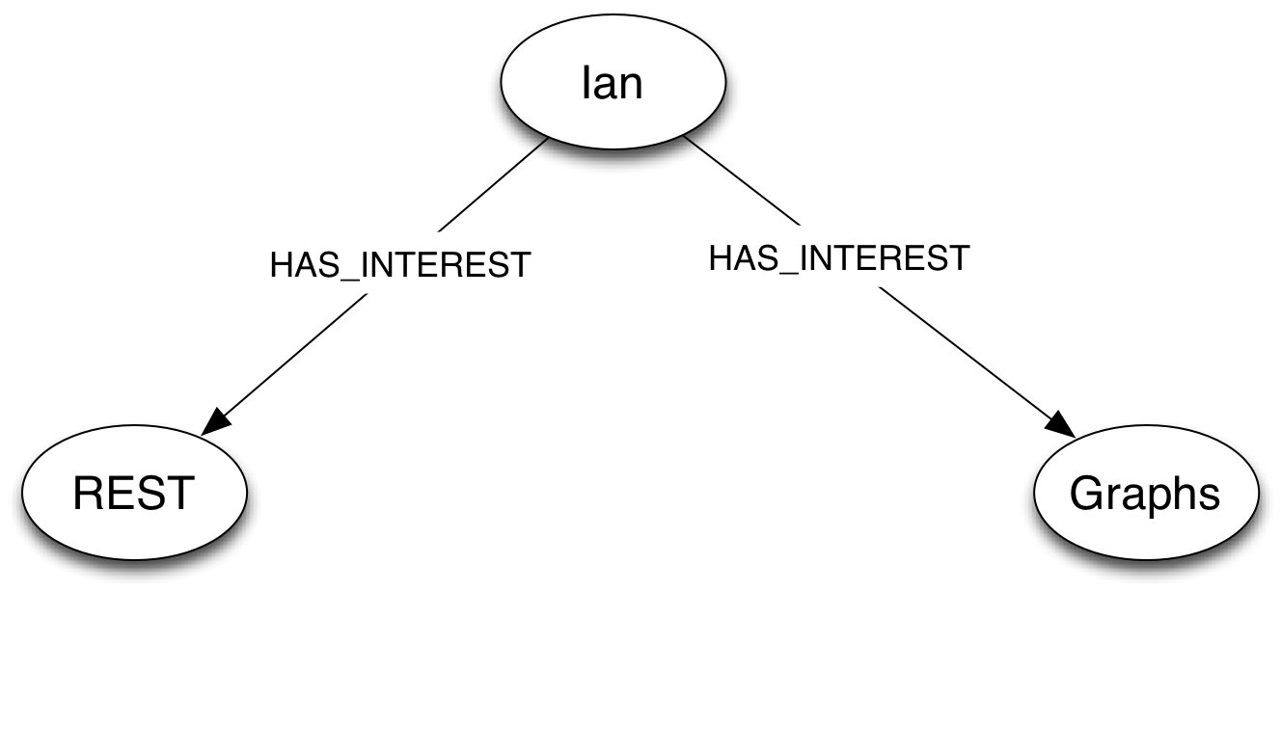
Non-Breaking Changes – Adding New Relationships
start ian=node:users(name=‘Ian’)
match (ian)-[:HAS_INTEREST]->(interest)
return interest

Slide 254
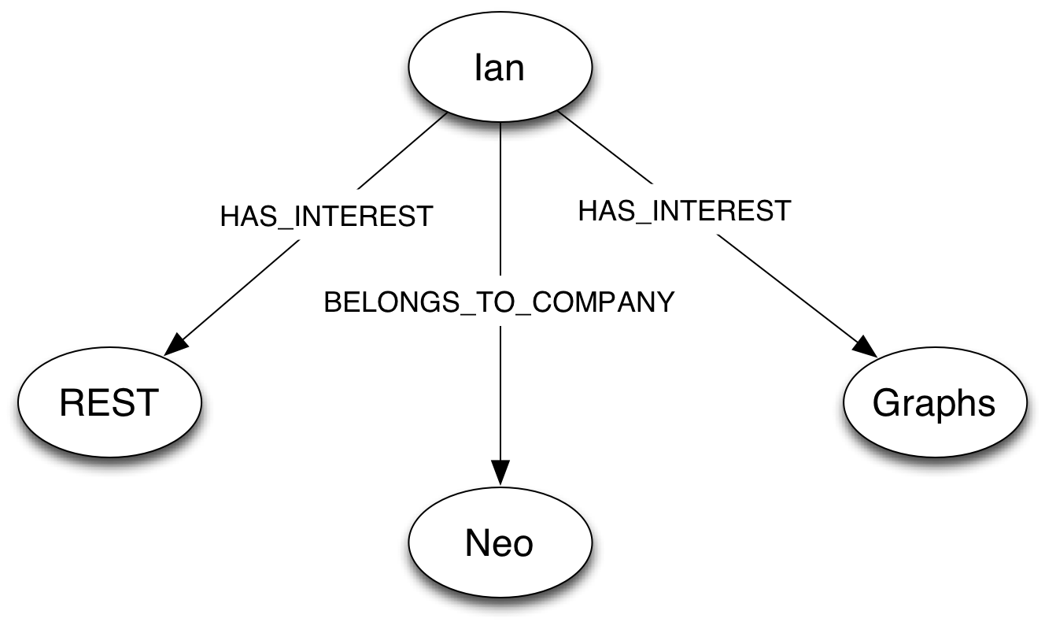
Non-Breaking Changes – Adding New Relationships
start ian=node:users(name=‘Ian’)
match (ian)-[:HAS_INTEREST]->(interest)
return interest

Slide 255
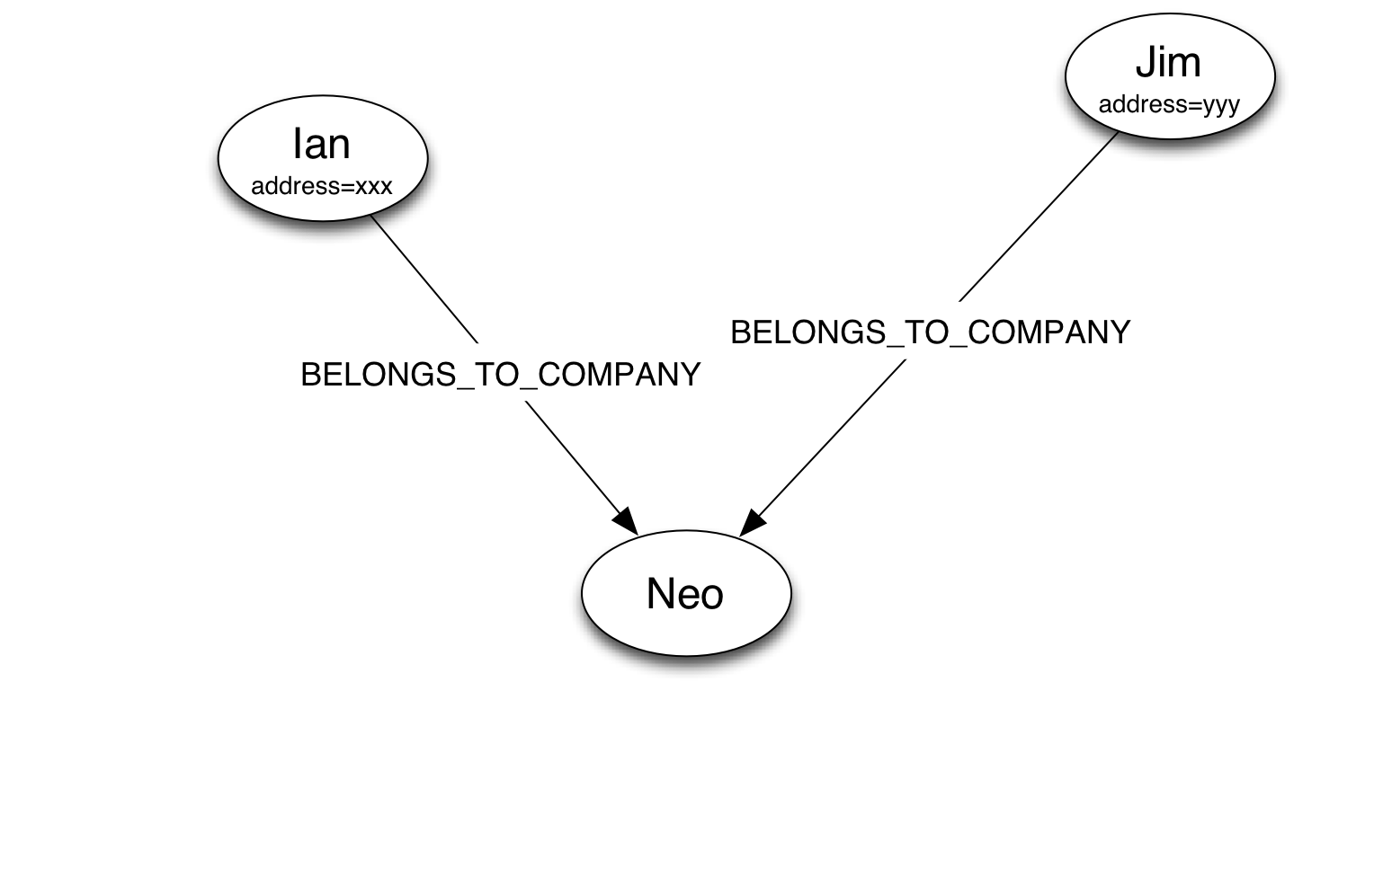
Breaking Changes – Pulling Out New Nodes From Existing Nodes
start neo=node:companies(name=‘Neo’)
match (neo)<-[:BELONGS_TO_COMPANY]-(employee)
return employee.address

Slide 256
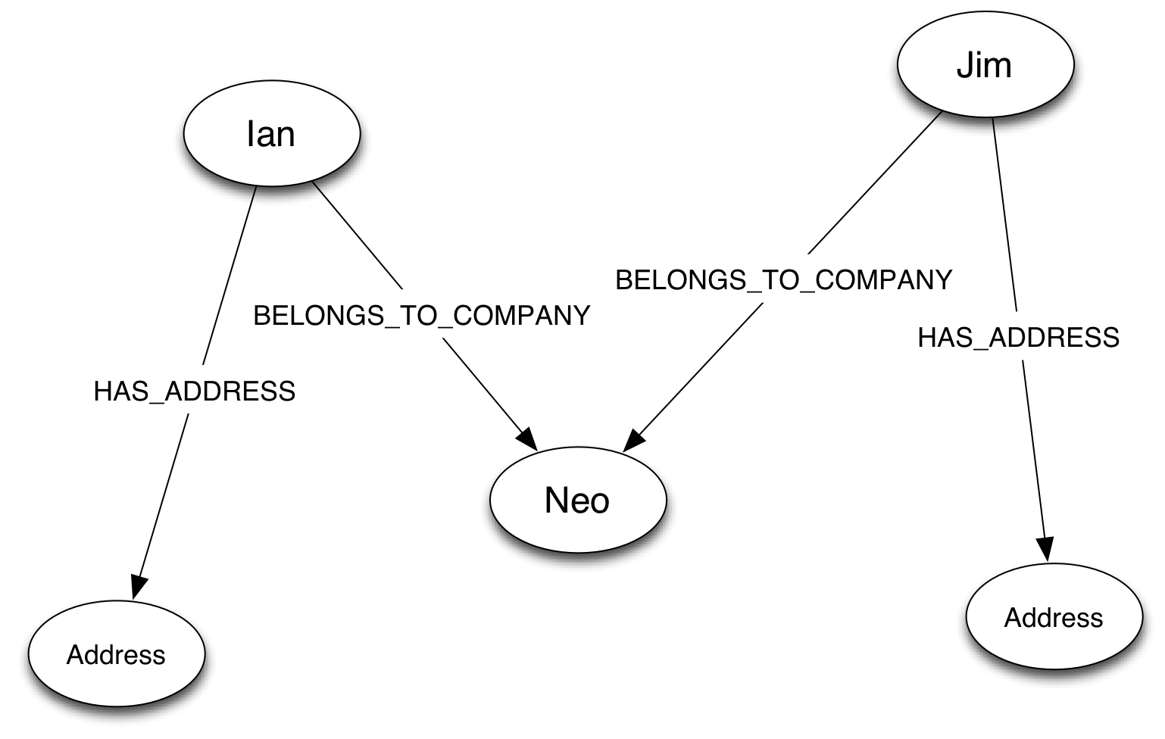
Breaking Changes – Pulling Out New Nodes From Existing Nodes
start neo=node:companies(name=‘Neo’)
match (neo)<-[:BELONGS_TO_COMPANY]-(employee)
return employee.address

Slide 257
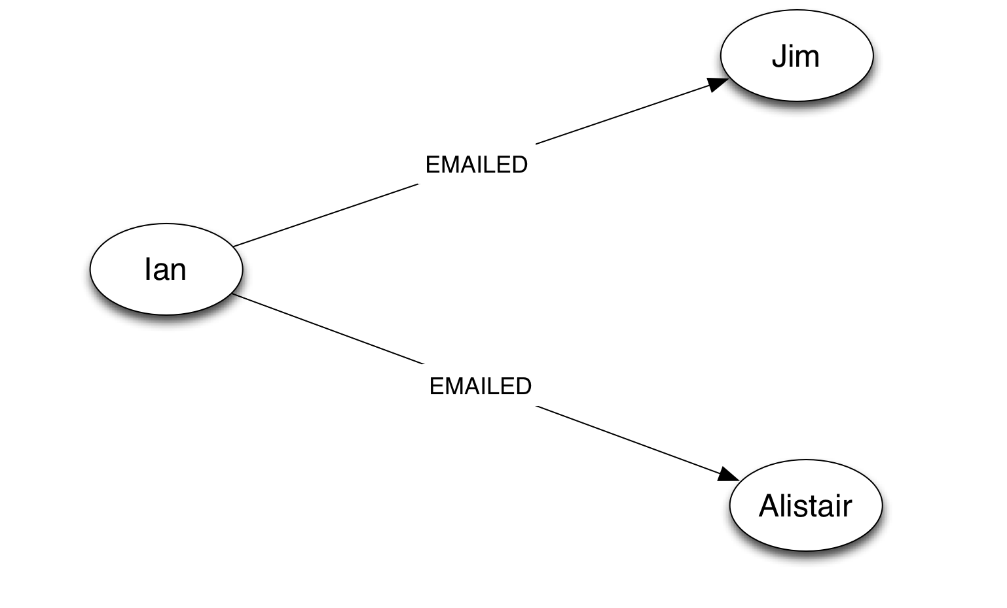
Breaking Changes – Pulling Out Node From Relationship
start ian=node:users(name=‘Ian’)
match (ian)-[email:EMAILED]->(recipient)
return email
Notes:
This is a bad model (remember, model actions in terms of their outputs or products)

Slide 258
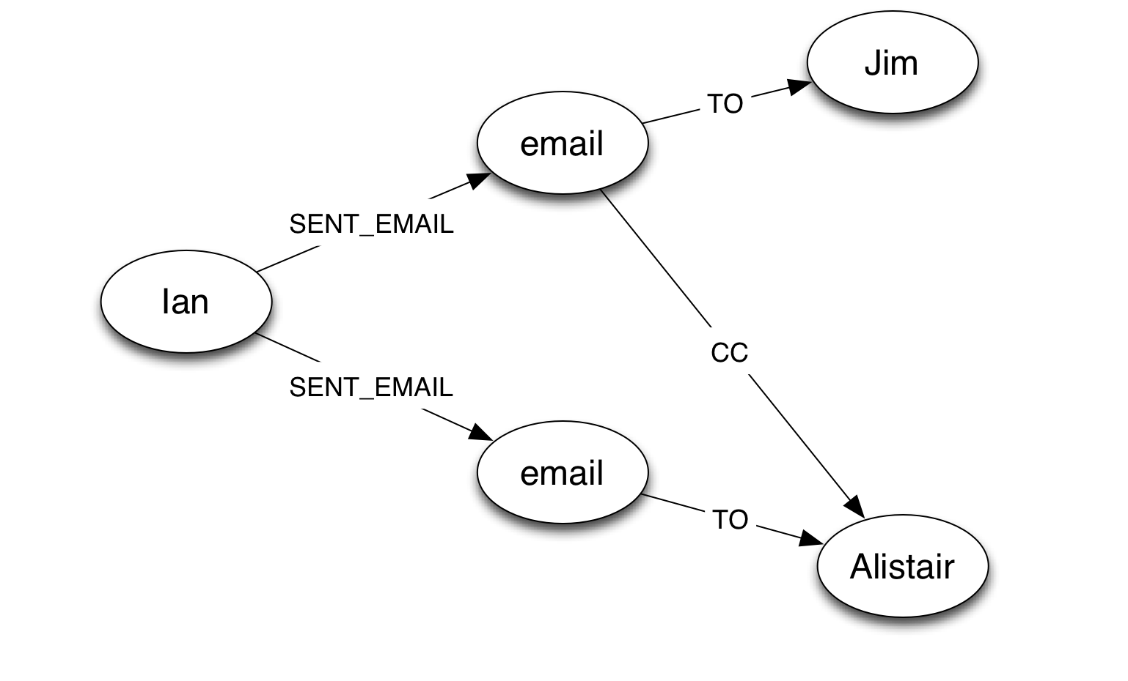
Breaking Changes – Pulling Out Node From Relationship
start ian=node:users(name=‘Ian’)
match (ian)-[email:EMAILED]->(recipient)
return email

Slide 259
Using Indexes
DO use indexes:
As a naming service, to look up start nodes
For optimization, to speed up access to nodes/relationships
DO NOT use indexes:
As a substitute for putting data in the graph
Ask yourself:
Could I rebuild my indexes based only on the data in the graph?

Slide 260
‘Typed’ Nodes
Several strategies:
Use a ‘type’ property
Use a category node and a IS_A relationship
‘Duck typing’: infer type based on relationship used to reach the node:
If HAS_CUSTOMER, treat as customer
If HAS_SUPPLIER, treat as supplier
Notes:
Neo4j doesn’t have node types. It doesn’t really have relationship types, just relationship names

Slide 261
Stores
Neo4j uses several stores:
Node
Relationship
Property
inclduing short strings and small arrays
String
for long strings
Array
for large arrays

Slide 262
Object Cache
Initially, only nodes and relationships, not properties, are loaded into memory
When you access one property, all properties for that node/relationship are loaded into memory
Long strings and large arrays are represented by placeholders
Long strings and large arrays are loaded on an as-needed basis

Slide 263
IDs
Internal implementation detail: IDs represent a file offset
IDs of deleted nodes/relationships can be reused between database restarts
DO NOT hold onto IDs or use them for lookups
node.getId() and relationship.getId() should never have been published!
For ID lookup, create your own IDs (e.g. UserID), and index them

Slide 264
What we haven’t covered…

Slide 265
Advanced Neo4j Topics
Kernel extensions
Add your own code to adapt the kernel
Listen for transaction lifecycles and respond
Running HA
Puppet/Chef, ZooKeeper, Ops hygiene

Slide 266
Spring Data Neo4j
Part of the Spring Data project
Domain objects backed by Nodes and Relationships
Wired up with AspectJ aspects
Or via repository pattern
A clean domain layer above Neo4j

Slide 267
Neo4j Spatial
Domain-specific add-on library for Geo computing
Storage
Store spatial objects in a way that supports spatial requirements
Search
Index spatial data for optimal search performance (both time and memory) as well as performance of spatial operations
Operations
Provide common spatial operations in the Neo4j API
I/O
Support import and export of spatial data using popular spatial standards

Slide 268
This is just the beginning... visit http://neo4j.org for more!
Ian Robinson
http://ianSrobinson.com
@ianSrobinson
Jim Webber
http://jimwebber.org
@jimwebber

